Slide 1

PLAINFIELD PUBLIC SCHOOLS
2026-2027
TENTATIVE BUDGET PROPOSAL
MARCH 24, 2026
Elizabeth Filippatos, Ed. D.
Acting Superintendent of Schools
Cameron E. Cox
Chief Financial Officer/Board Secretary

Slide 2

INFORMATION
Plainfield Public School District
Quick Facts about the:
Audit Impact on the Budget Process
Health Insurance Costs
Usage of Reserves and Fund Balances
Click here to access this document.

Slide 3
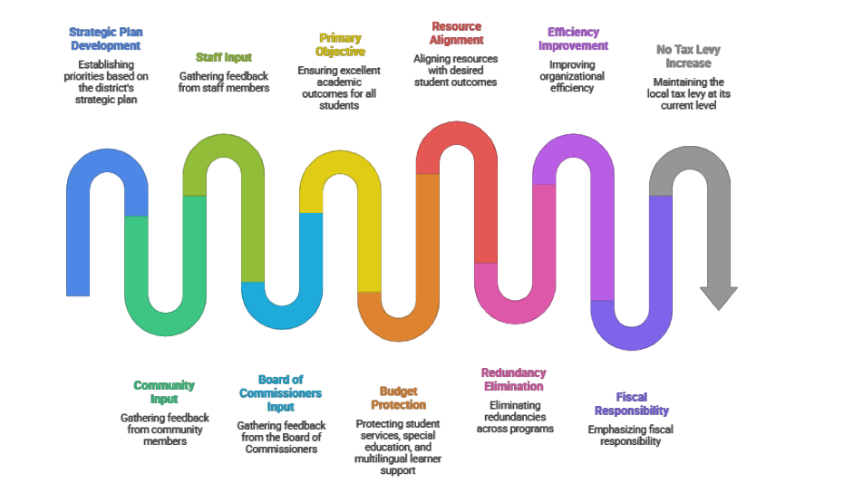
BUDGET DEVELOPMENT PROCESS

Slide 4

BUDGET SURVEY FEEDBACK

Slide 5
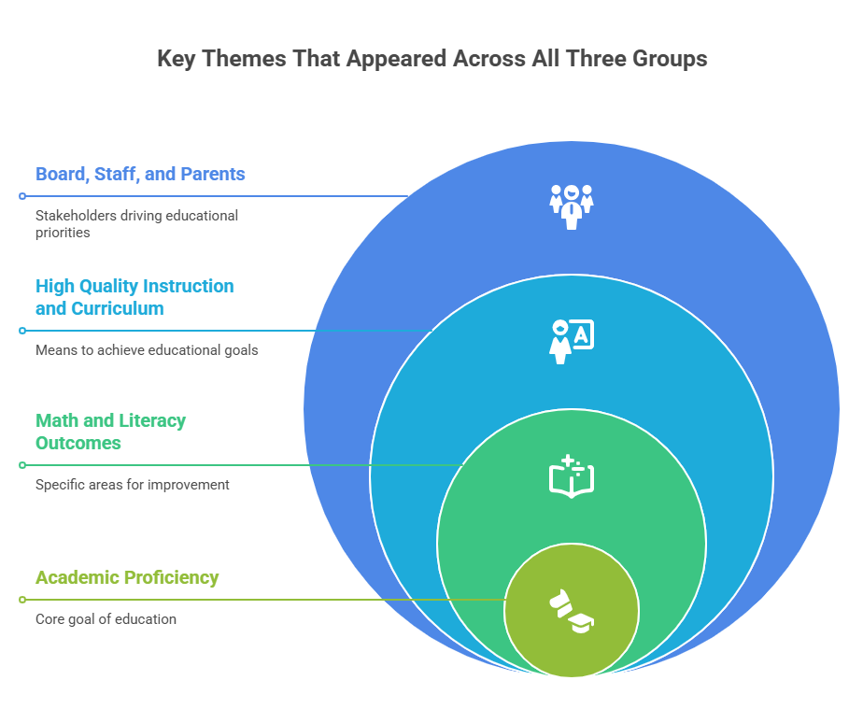

Slide 6
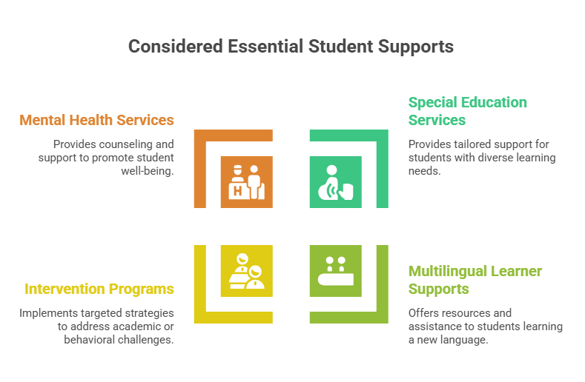
CONSIDERED ESSENTIAL STUDENT SUPPORTS

Slide 7
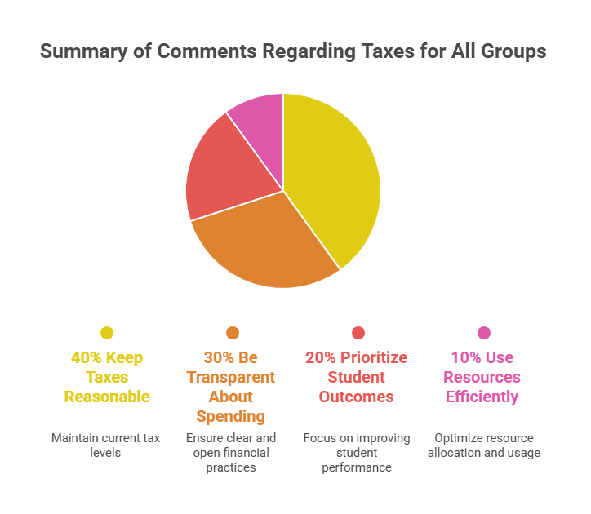
SUMMARY OF COMMENTS REGARDING TAXES FOR ALL SURVEYED GROUPS

Slide 8

BUDGET PRIORITY: PROTECTING STUDENT SUPPORTS & CLASSROOM EXPERIENCE
Classroom & Instructional Supports
No Increase in Class Sizes
Maintaining class sizes within recommended levels to support effective instruction
Full Access to Materials & Supplies
Ensuring every student has the resources needed for learning
Instructional Coaching for New Teachers
Continued support to strengthen teaching quality and student outcomes
Student Support & Enrichment
Academic Intervention Services Protected
Sustaining targeted supports for students who need additional help
Afterschool & Supplemental Programs Preserved
Protecting enrichment, extracurriculars, and extended learning opportunities
Restructuring the Office of
Information Technology

Slide 9
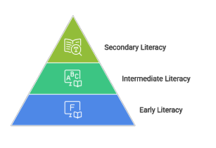
DISTRICT-WIDE LITERACY FOCUS (K-12)
A Coherent, System-wide Approach to Literacy Improvement
Early Literacy (K–2)​
  Foundational skills (Fundations & Heggerty)​
  Science of Reading: phonics, fluency, comprehension​
  Early writing development​
  Targeted interventions​
Intermediate Literacy (3–5)​
  Comprehension, vocabulary, writing​
  Targeted interventions (Pilot Just Words)​
  Writing across genres/content areas​
Secondary Literacy (6–12)​
  Interdisciplinary literacy (ELA, Science, SS, CTE)​
  Focus on writing, analysis, critical thinking​
Literacy Development Pyramid

Slide 10
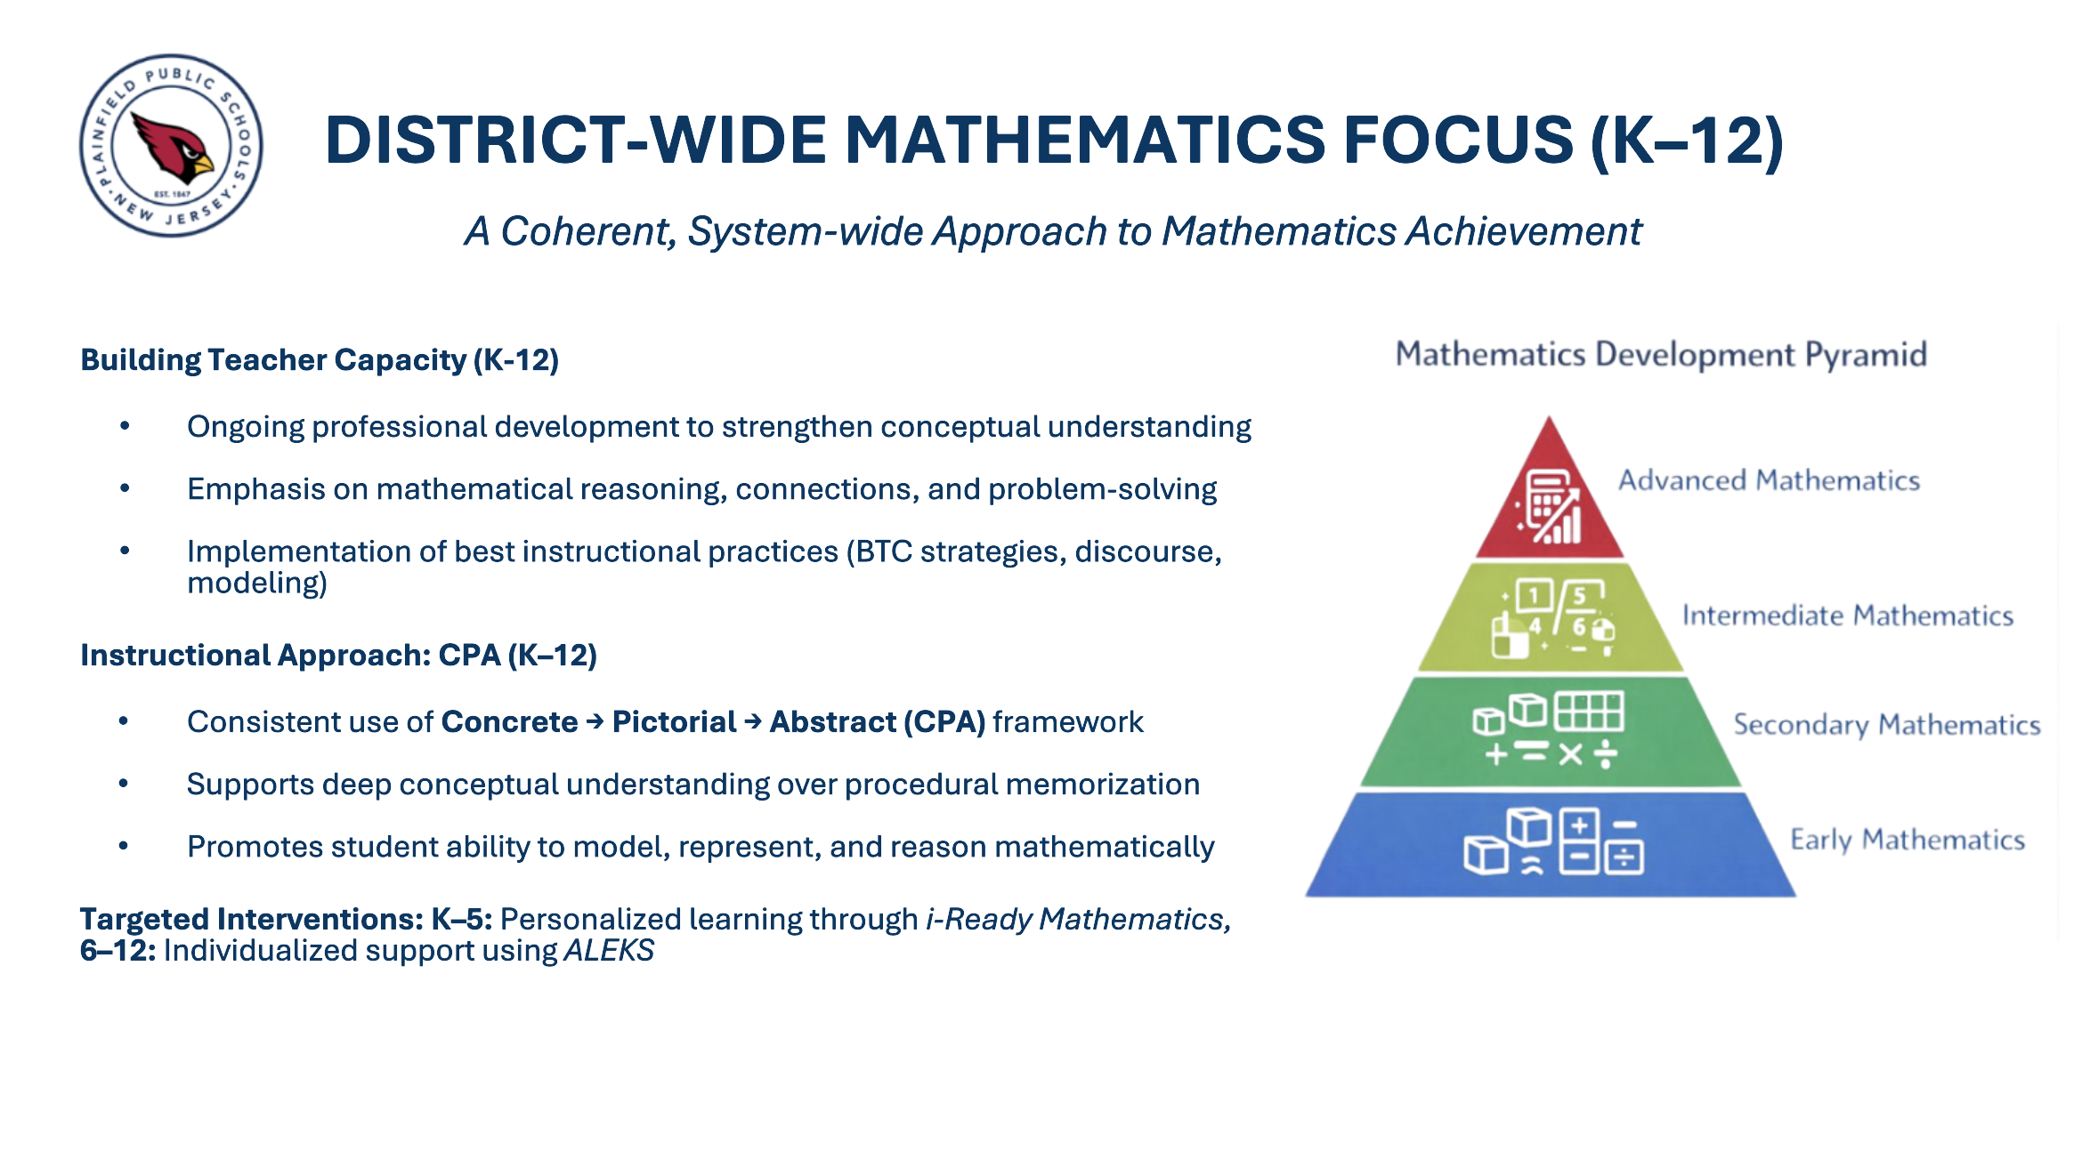

Slide 11
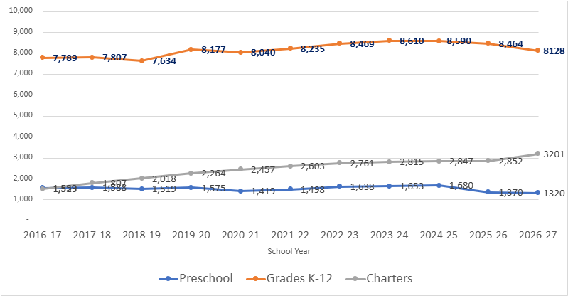
ENROLLMENT TRENDS
Projected
Enrollment

Slide 12
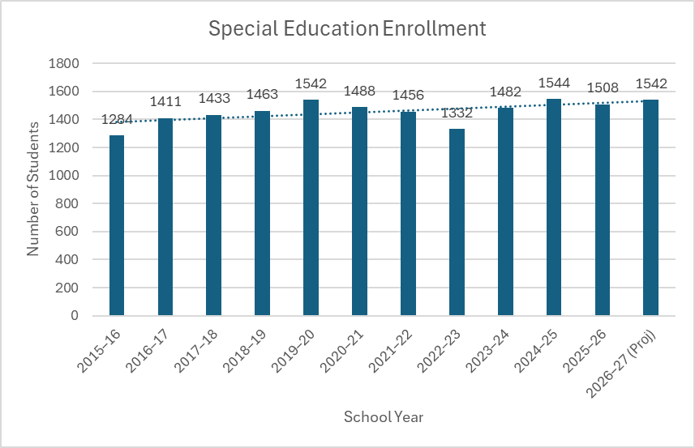

SPECIAL EDUCATION ENROLLMENT

Slide 13
SPECIAL EDUCATION FUNDING
FY Year | 2024-25 | 2025-26 | 2026-27 (Projected)
RELATED SERVICES | $1,865,477 | $2,026,227 | $2,077,096
Out-of-District Students | $20,073,762 | $24,432,707 | $23,729,644
Special Education - Instruction | $16,128,560 | $16,708,376 | $24,480,761
TOTAL | $38,067,799 | $43,167,310 | $50,287,501

Slide 14
CHARTER SCHOOL ENROLLMENT
Projected Enrollment

Slide 15

CHARTER SCHOOLS, CONT
Total charter payments in this budget increased by $3.46M
Charter School | FY26 Enrollment | FY27 Enrollment | Change | FY26 Payment | FY27 Payment | Change
Central Jersey College Prep (Somerset, NJ) | 13 | 10 | ▼ 3 | $281,347 | $208,469 | ▼ $72,878
Barack Obama Green Charter | 355 | 351 | ▼ 4 | $7,791,856 | $8,072,039 | ▲ $280,183
Thomas Edison Energysmart (Franklin Township, NJ) | 1 | — | ▼ 1 | $23,515 | — | ▼ $23,515
College Achieve Central | 1,410 | 1,440 | ▲ 30 | $29,823,653 | $31,758,479 | ▲ $1,934,826
Cresthaven Academy | 654 | 635 | ▼ 19 | $13,087,299 | $13,558,645 | ▲ $471,346
New Horizons Comm. CS (Newark, NJ) | 1 | 1 | — | $12,224 | $12,896 | ▲ $672
North Star Academy (Newark, NJ) | 8 | 7 | ▼ 1 | $148,623 | $128,973 | ▼ $19,650
TEAM Academy Charter (Newark, NJ) | 6 | 4 | ▼ 2 | $120,345 | $92,900 | ▼ $27,445
Queen City Academy | 483 | 476 | ▼ 7 | $10,404,745 | $10,849,040 | ▲ $444,295
Union County TEAMS CS | 294 | 277 | ▼ 17 | $5,585,985 | $6,074,456 | ▲ $488,471
Unity CS (Morris Township, NJ) | 1 | — | ▼ 1 | $12,224 | — | ▼ $12,224

Slide 16

STATE AID UPDATE
Plainfield Public Schools has received its 2026–2027 State Aid Notice from the New Jersey Department of Education. The district will see an increase in gross state aid of $5,834,336 million; however, updated charter school tuition obligations have also increased, rising from approximately $67.3 million to $70.7 million.
After accounting for these required increase in Charter payments, the net additional funding available to support district operations is approximately $2.4 million.

Slide 17


AUDIT
Plainfield Public Schools
Annual Comprehensive Financial Report
For the Year Ended
June 30, 2025
Uploaded to District Website: February 5, 2026
Click here to access this document.
Plainfield Public Schools
Auditors’ Management Report on Administrative Findings
For the Year Ended
June 30, 2025
Uploaded to District Website: February 5, 2026
Click here to access this document.

Slide 18
REVENUE ANALYSIS
Revenues | 24-25 | 25-26 Budget | % Changes |  | 26-27 Budget | % Changes
Local Tax Levy | $26,018,540 | $30,990,123 | 19.11% |  | $30,990,123 | 0.00%
Tuition | $111,907 | $111,932 | 100.00% |  | $0 | -100.00%
Interest On Investments | $1,304,461 | $950,000 | 1000.00% |  | $480,000 | -49.47%
Misc. Revenues | $729,809 | $64,996 | -91.09% |  | $27,126 | -58.27%
Total From Local Sources | $28,164,717 | $32,117,051 | 14.03% |  | $31,497,249 | -1.93%
Extraordinary Aids | $5,266,508 | $2,250,000 | -57.28% |  | $3,250,000 | 44.44%
Equalization Aid | $241,922,902 | $256,395,528 | 5.98% |  | $260,790,155 | 1.71%
Educational Adequacy Aid | $11,009,173 | $11,009,173 | 0.00% |  | $11,009,173 | 0.00%
Transportation Aid | $2,624,902 | $2,277,345 | -13.24% |  | $2,967,252 | 30.29%
Special Categorical Education Aid | $13,960,780 | $12,559,729 | -10.04% |  | $13,400,629 | 6.70%
Security Aid | $6,696,257 | $5,841,937 | -12.76% |  | $5,807,930 | -0.58%
Others Federal and State grants | $5,015,219 | $57,091 | -98.86% |  | $57,091 | 0.00%
Total from State & Federal Sources | $286,495,741 | $290,390,803 | 1.36% |  | $297,282,230 | 2.37%
TOTAL REVENUES | $314,660,458 | $322,507,854 | 2.49% |  | $328,779,479 | 1.94%
Budgeted Fund Balance | $4,762,562 | $8,291,117 | 100.00% |  | $4,000,000 | -51.76%
Capital Reserve Withdrawal | $14,500,000 | $0 | 0.00% |  | $4,000,000 | 100.00%
Maintenance Reserve Withdrawal | $2,500,000 | $0 | 0.00% |  | $0 | 100.00%
Revenues from Reserves/Surplus | $21,762,562 | $8,291,117 | 100.00% |  | $8,000,000 | -3.51%
Total Revenues | $340,015,355 | $330,798,971 | -2.71% |  | $336,779,479 | 1.81%

Slide 19
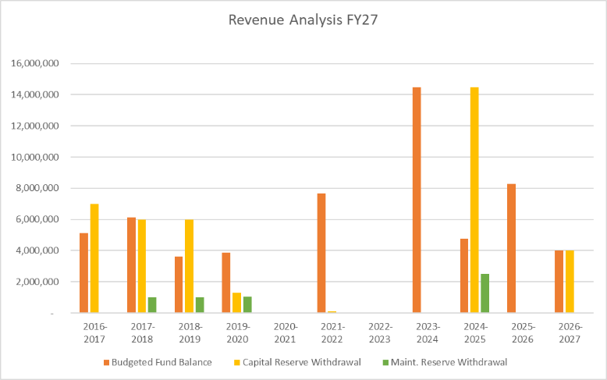


Slide 20
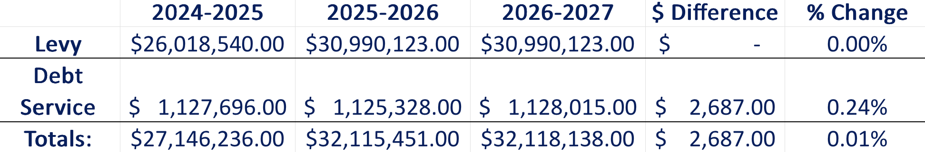
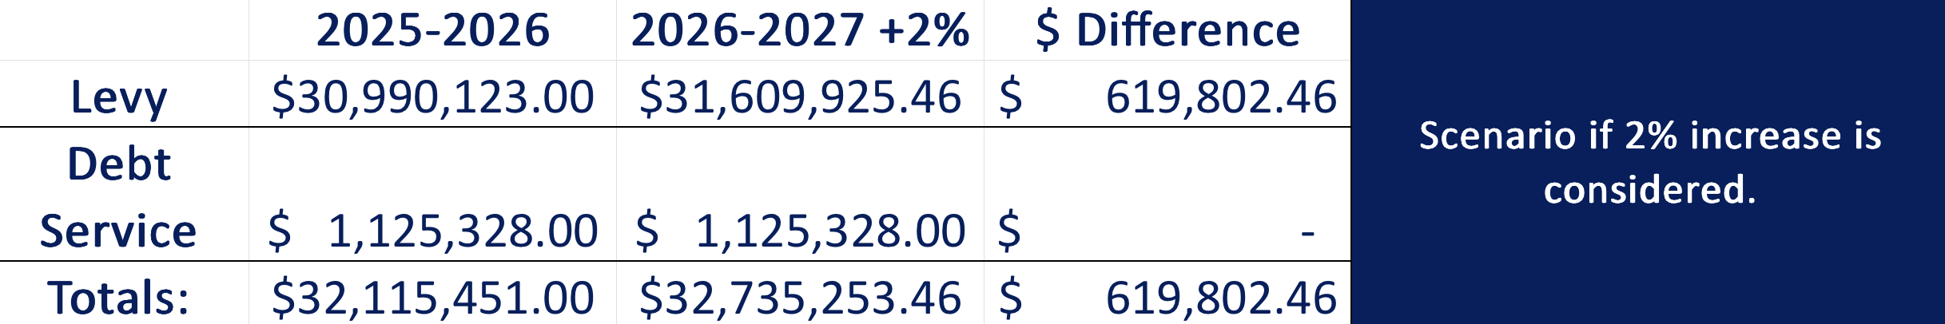
LOCAL TAX LEVY
Scenario of 2% Increase

Slide 21
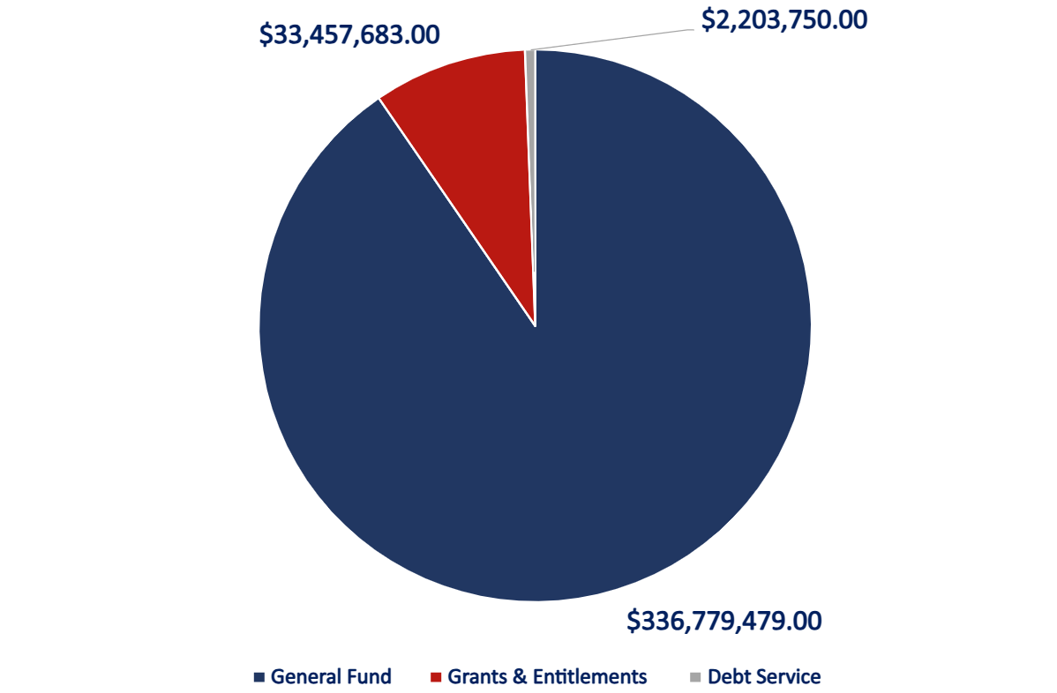
GENERAL FUND SNAPSHOT

Slide 22
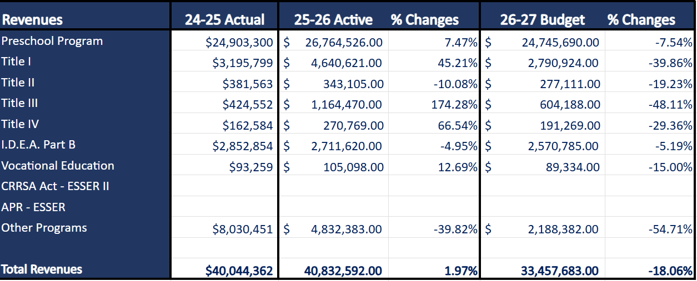
SPECIAL REVENUES

Slide 23

KEY BUDGET DRIVERS
  Key Drivers
  Decreased Student Enrollment
  Rising Charter School Payments
  Rising Health Insurance Costs
  Societal Inflation: Operational Costs
Plainfield Public School District
Quick Facts about the:
Audit Impact on the Budget Process
Health Insurance Costs
Usage of Reserves and Fund Balances

Slide 24
SALARIES & BENEFITS
 | 2024-2025 | 2025-2026 | 2026-2027
Salaries: | $130,683,333.00 | $142,394,082.00 | $138,032,076.30
Benefits: | $44,612,375.00 | $52,070,059.62 | $59,758,276.27
Totals: | $175,295,708.00 | $194,464,141.62 | $197,790,352.57
Tot. GF Budget | $340,015,355 | $330,798,971.00 | $336,779,479.00
% of GF Budget | 51.56% | 58.79% | 58.73%
Notes:
Over the three-year period, salary costs increased from $130.7M to $142.4M, before decreasing to $138.0M, reflecting recent right-sizing and staffing adjustments.
At the same time, benefit costs steadily increased each year, rising from $44.6M to $59.8M, placing continued upward pressure on overall personnel expenses.
As a result, total personnel costs (salaries + benefits) grew from $175.3M to $197.8M across the period.
While the overall general fund budget fluctuated—decreasing and then slightly increasing ($340.0M → $330.8M → $336.8M)—personnel costs now make up a larger share of the budget, increasing from 51.6% to approximately 58.7%.
Key takeaway:
Even with reductions in salary expenses in the most recent year, rising benefit costs have continued to drive overall personnel spending upward, resulting in a higher percentage of the total budget dedicated to staffing.

Slide 25
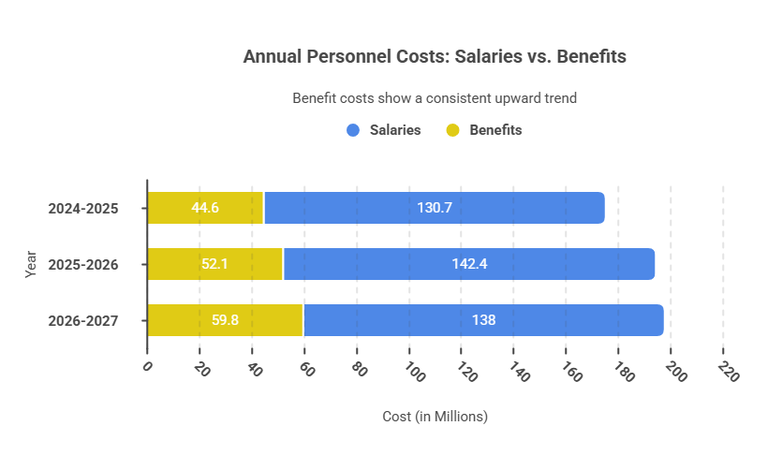

Slide 26
APPROPRIATIONS
PROGRAMS | 2024-25 Expenditures | 2025-26 Budget | 2026-27 Budget | $ Difference | % Inc/Dec
INSTRUCTION | $100,123,602 | $104,156,529 | $97,360,256 | $(6,796,273) | -6.53%
BENEFITS | $44,612,375 | $50,887,171 | $59,758,276 | $8,871,105 | 17.43%
SCHOOL-SPONDS ATHLETICS INSTRUCTION | $1,857,886 | $1,653,097 | $1,440,996 | $(212,101) | -12.83%
SUMMER SCHOOLS | $464,546 | $544,841 | $6,000 | $(538,841) | -98.90%
TUITION | $20,506,720 | $20,096,253 | $23,729,644 | $3,633,391 | 18.08%
STUDENT SUPPORT SERVICES | $13,367,425 | $14,167,148 | $15,093,769 | $926,621 | 6.54%
IMPROVEMENT OF INSTRUCTION & TRAINING | $10,344,674 | $8,701,308 | $8,240,505 | $(460,803) | -5.30%
ADMINISTRATION AND CENTRAL SERVICES | $14,365,676 | $13,473,382 | $12,117,567 | $(1,355,815) | -10.06%
INFORMATION MGMT | $3,679,140 | $4,473,696 | $3,746,245 | $(727,451) | -16.26%
OPS & MAINTENANCE OF PLANT & SECURITY | $28,761,528 | $22,745,655 | $28,999,843 | $6,254,188 | 27.50%
TRANSPORTATION | $9,817,509 | $11,032,982 | $12,629,717 | $1,596,735 | 14.47%
GENERAL FUND GRAND TOTAL | $247,901,080 | $249,406,151 | $263,122,818 | $13,716,667 | 5.50%
CAPITAL OUTLAYS | $27,716,938 | $12,229,421 | $4,400,764 | $(7,828,657) | -64.01%
CHARTER SCHOOLS | $62,825,741 | $67,291,816 | $70,755,897 | $3,464,081 | 5.15%
TOTAL APPROPRIATIONS | $338,443,759 | $328,927,388 | $338,279,479 | $9,352,091 | 2.84%

Slide 27
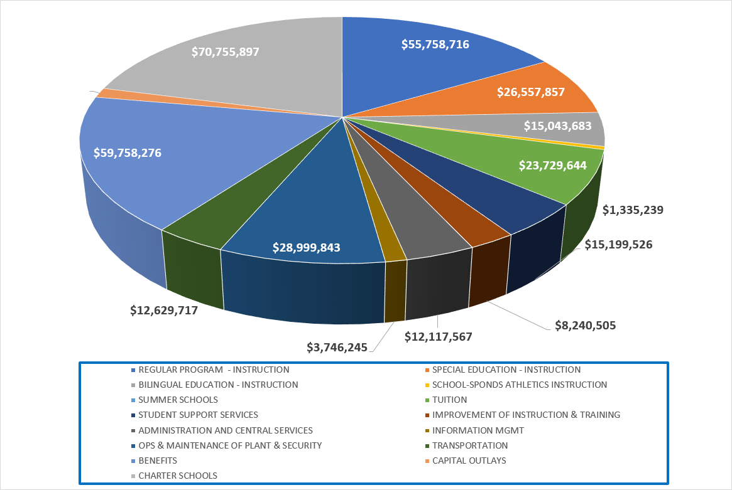
APPROPRIATIONS PIE

Slide 28
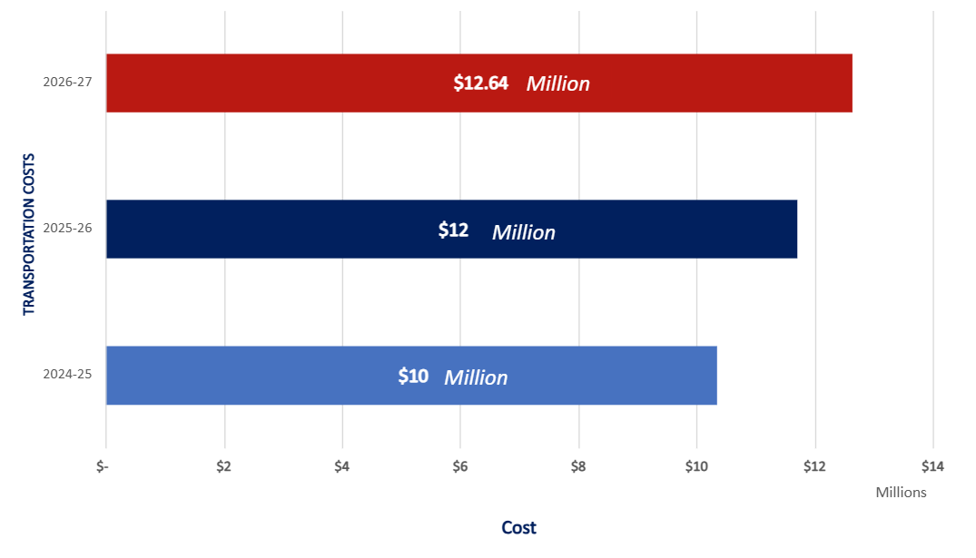
TRANSPORTATION COSTS

Slide 29
SUMMARY OF SPECIFIC REDUCTIONS TO SPENDING
 | 24-25 Actual | 25-26 Revised Budget | 26-27 Projection | To Change | % Change
Travel | $428,800.85 | $510,745.81 | $314,479.00 | -$196,266.81 | -38.43%
Supplies | $8,644,331.30 | $5,920,181.06 | $4,270,304.71 | -$1,649,876.35 | -27.87%
Consultants | $1,424,332.58 | $2,744,700.13 | $790,656.24 | -$1,954,043.89 | -71.19%
Software | $2,203,500.00 | $4,036,682.00 | $2,929,650.00 | -$1,107,032.00 | -27.42%
Aggregate Non-Salary Cost | $113,864,348.00 | $109,211,602.00 | $104,833,472.00 | -$4,378,130.00 | -4.01%
Staff Type | Potential Reduced
Administration | 15%
Certificated Staff | 4%
Noncertificated | 5%

Slide 30
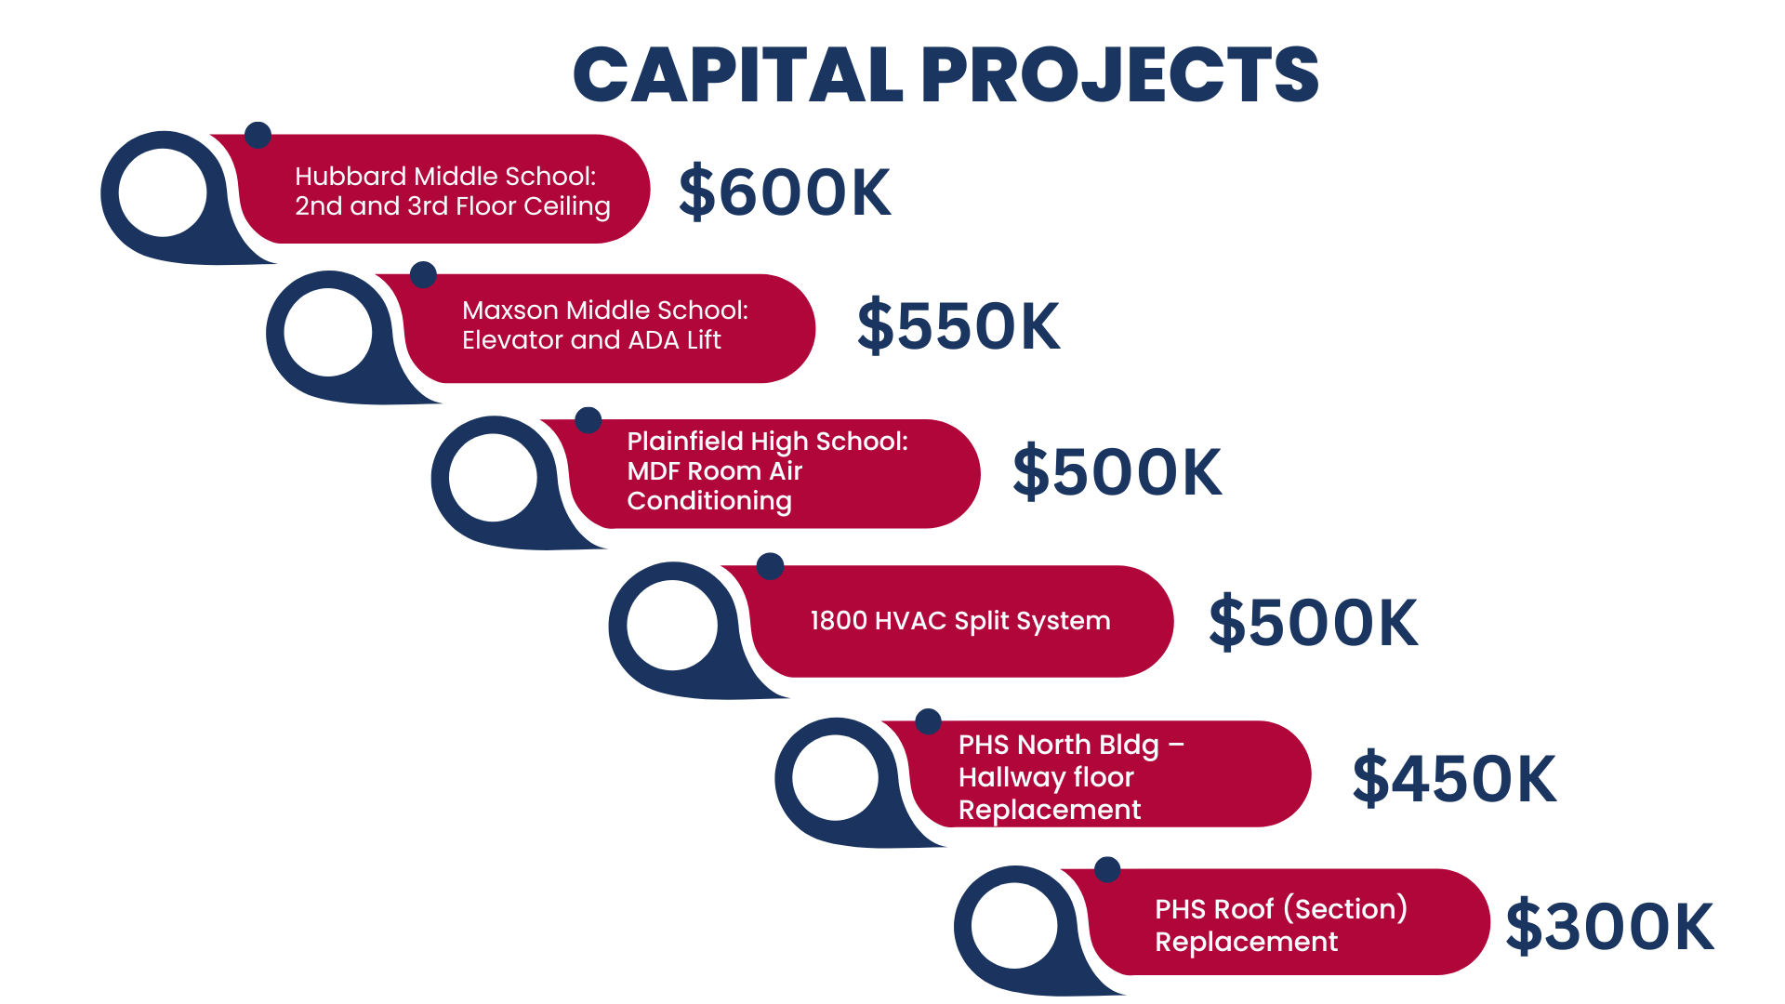

Slide 31
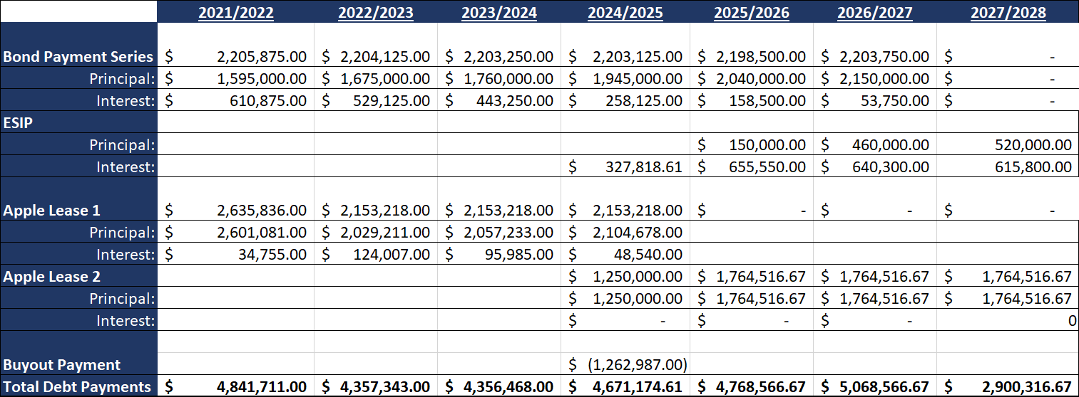

LONG TERM DEBT

Slide 32
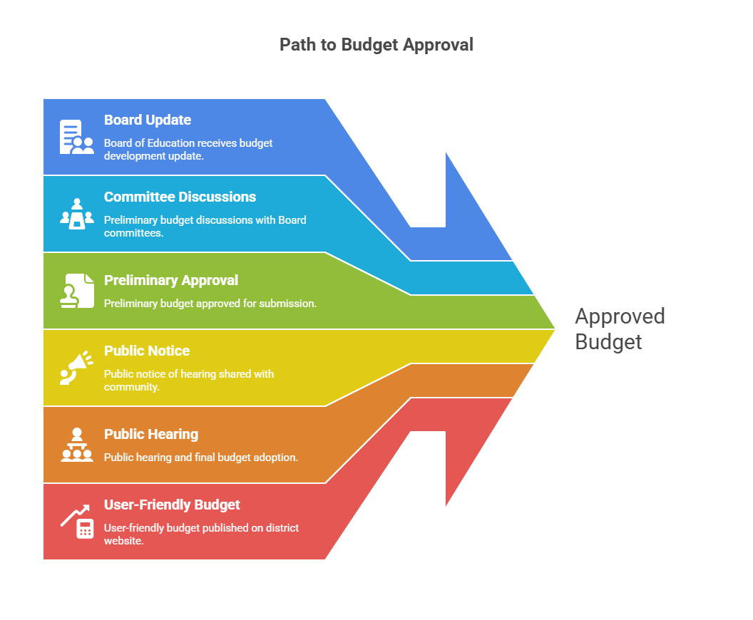



Current Phase:
Preliminary Approval for Budget Approval for Submission

Slide 33


QUESTIONS

Slide 34
THANK YOU!

