Slide 1
Welcome!
BOND 2020
Community Meeting
Capital Development & Construction Services | Spring 2026
Notes:
Welcome to Bond 2020 and Operations community meeting

Slide 2
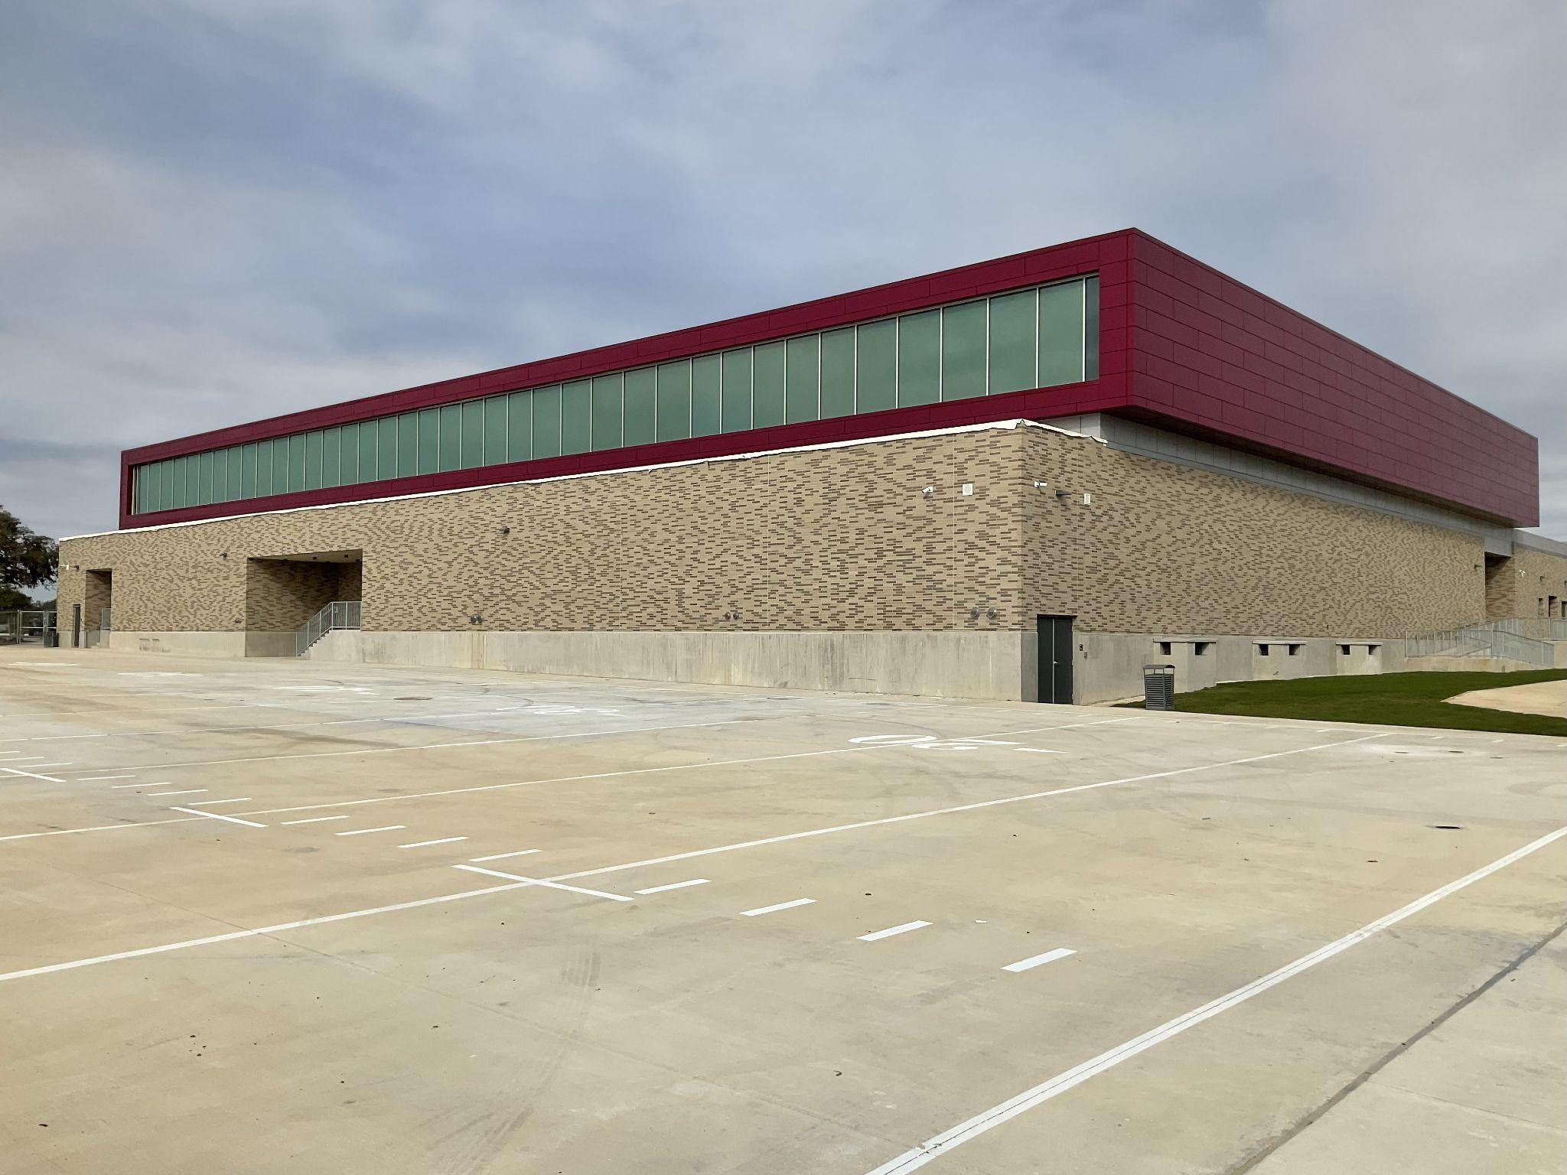
What is in Bond 2020?
Total $1.3 Billion
Prop A ($1.21 Billion)
Major renovations for 36 campuses
Safety upgrades at all schools
Replacement of HVAC equipment that is more than 15 years old (30 campuses)
Classroom renovations for facilities that house new school models
Prop B ($90 Million)
Tech upgrades:
High-speed connectivity
Audio systems
Interactive smart boards
Devices
Support tools and the necessary infrastructure
Original Plan (36 Total Projects) | Current (52 Total Projects)
Notes:
Our most current Bond was passed in 2020. Bond 2020 is made up of two propositions: Proposition A which was $1.2 Billion dollars for 36 Major campus renovations. Proposition A also included safety upgrades and HVAC replacement for equipment that was 15 years old. Proposition B was $90 million dollars it was dedicated to technology infrastructure, high speed connectivity, student devices, smart boards and audio systems. Both propositions totaled $1.3 Billion dollars. The original bond plan included 36 projects and currently we have 52 projects identified. There will be additional details about these projects later in the presentation.

Slide 3
Project Status

Slide 4

Bond Overview
In November 2020, voters approved two propositions totaling $1.3 billion:
PROP A
$1.21 billion for:
Campus renovations/upgrades, including HVAC upgrades
Security upgrades at all schools
Replacement of air-conditioning chillers more than 15 years old at schools not receiving major renovations
Capital Improvement - Prop A
Bond Total | $ 1, 210,000,000 | % of total
In Design | $ 459,318,623 | 38%
Total Spent | $ 750,681,377 | 62%
PROP B
$90 million for technology upgrades for all schools
Technology - Prop B
Bond Total | $90,000,000 | % of Total
Expensed | $77,159,374 | 86%
Notes:
Currently, over half of the bond program is under contract (Encumbered & Expensed). The remaining projects are in design and we are on track to have the remaining identified projects under construction within the 12-14 months.

Slide 5
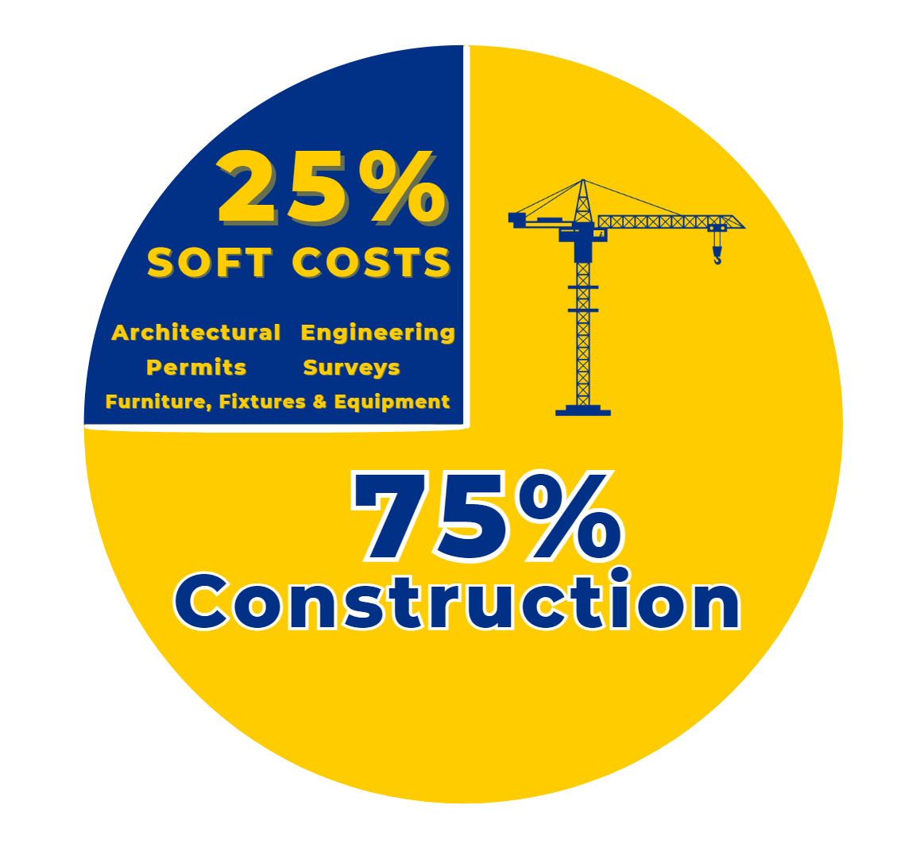
Breakdown of Project Costs

Slide 6

Soft Cost vs Construction Cost
25% of budget | 75% of budget
Soft Cost | Construction Cost
Architectural Design Fees | Cost of Construction Work
Engineering Fees
Surveys & Exploratory Analysis
Permitting & Regulatory Fees
Furniture, Fixtures & Equipment (FF&E)
Temporary Facilities (Swing Space)
Technology Infrastructure

Slide 7
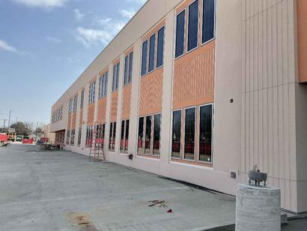
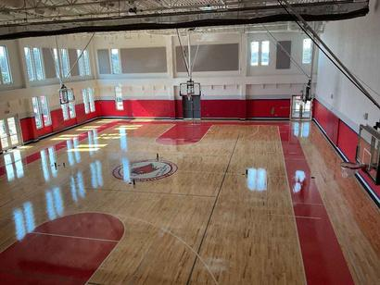
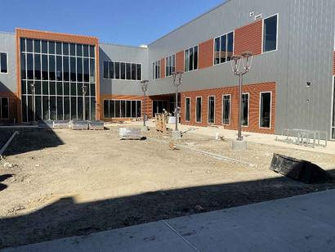
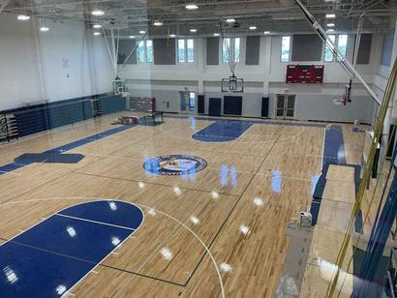
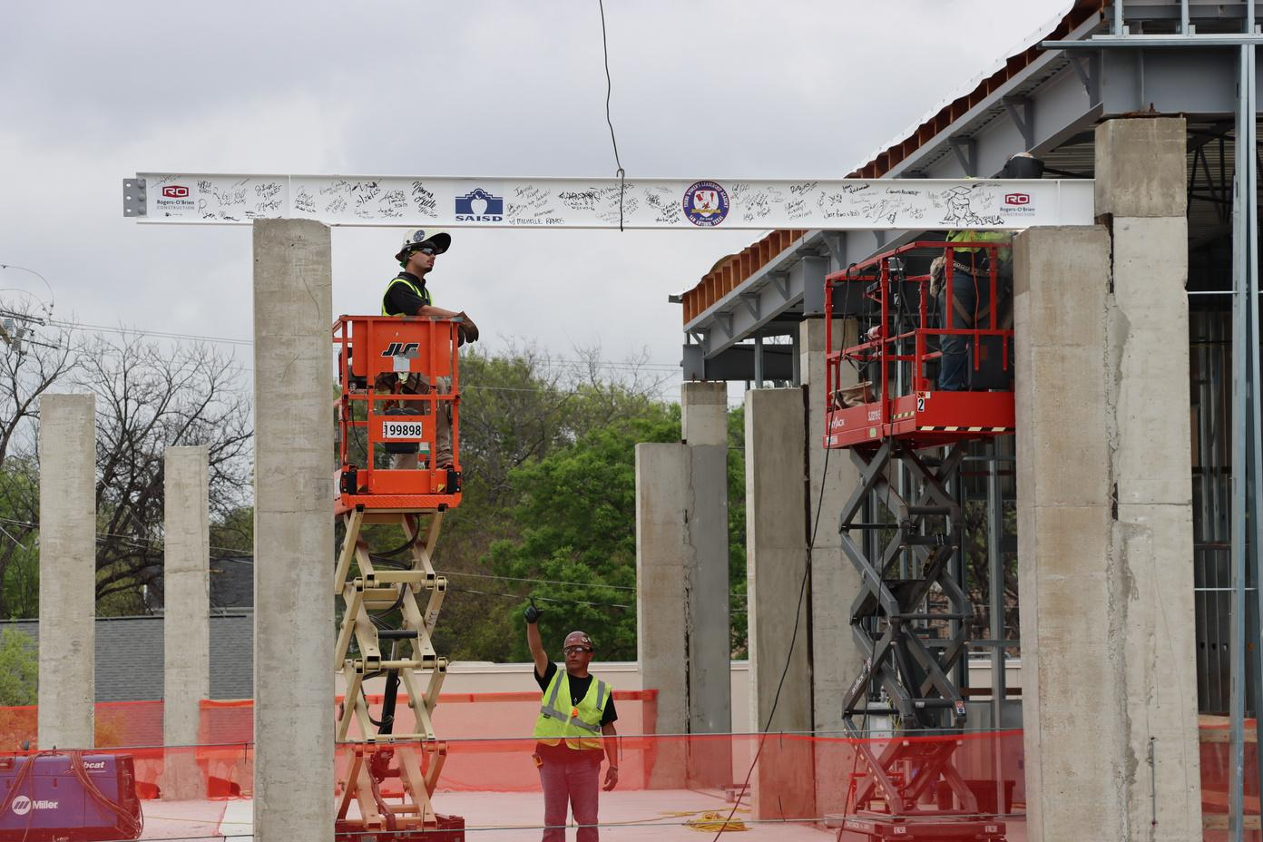
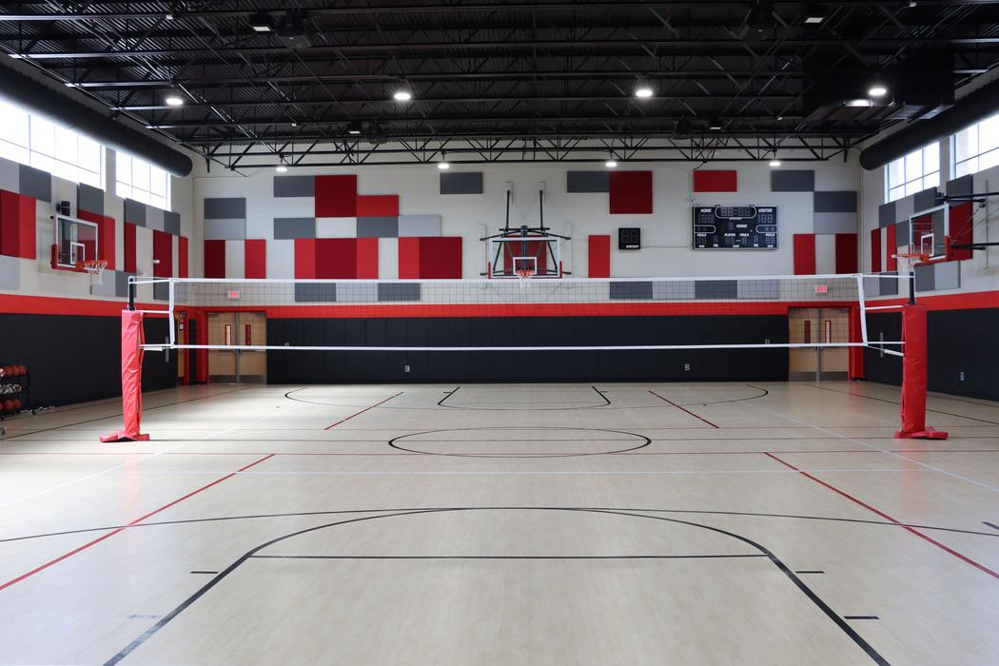
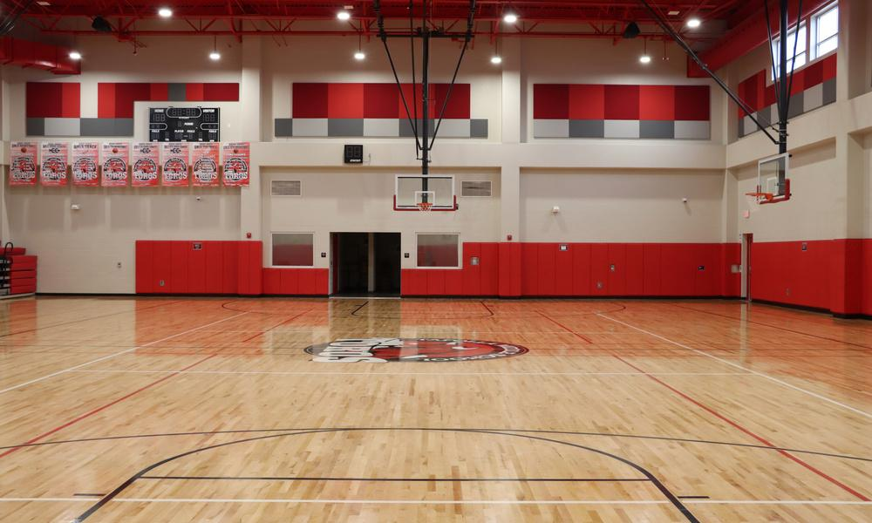
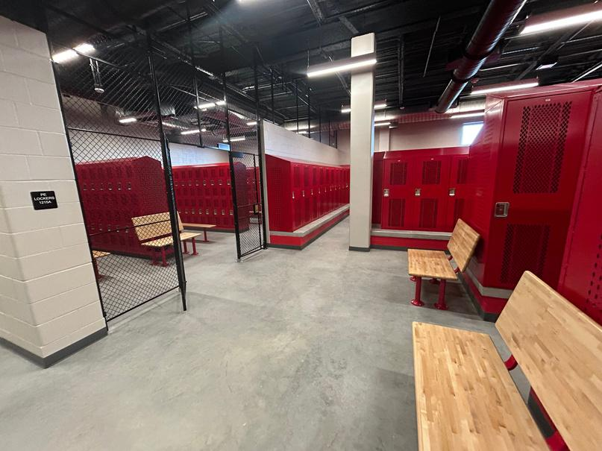
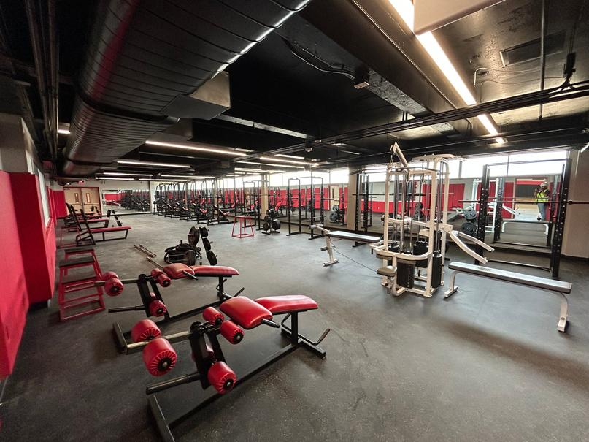
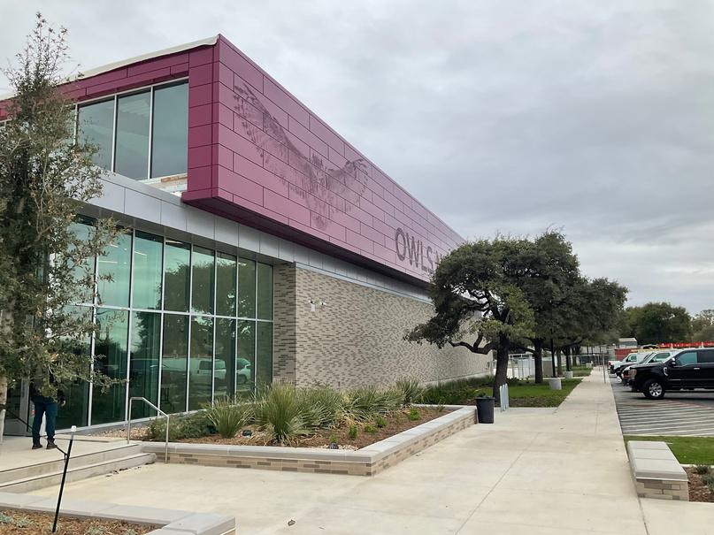
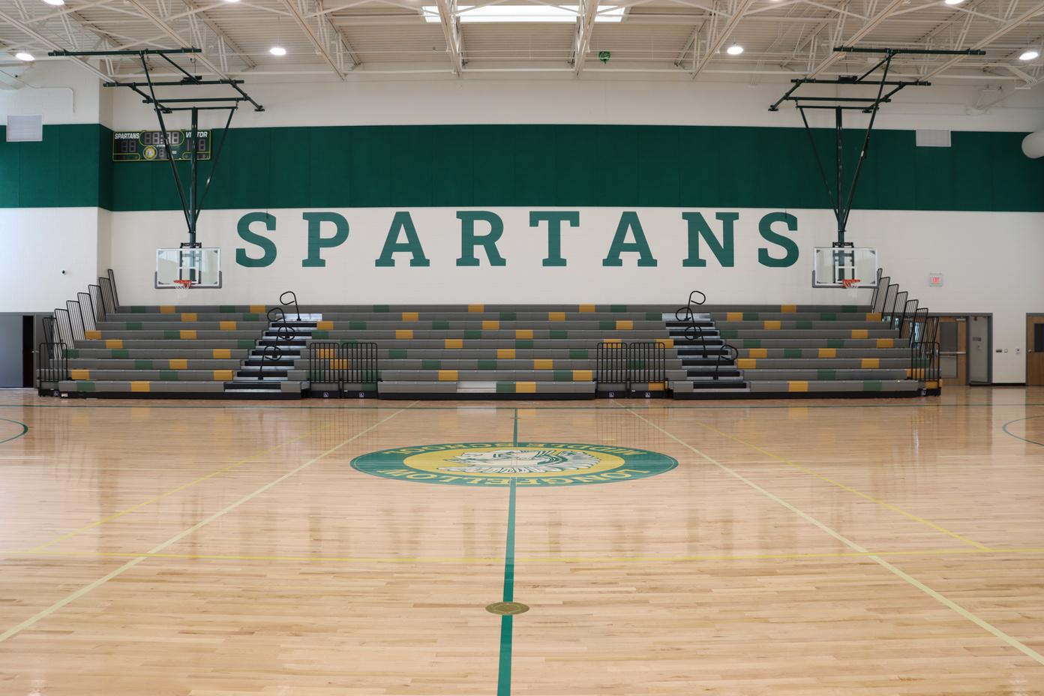
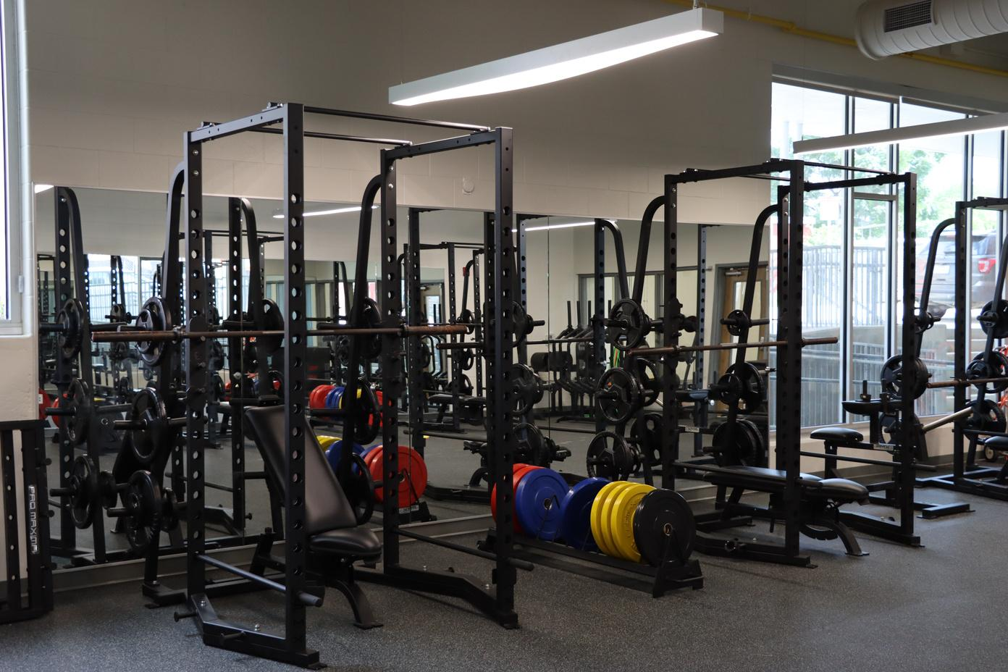
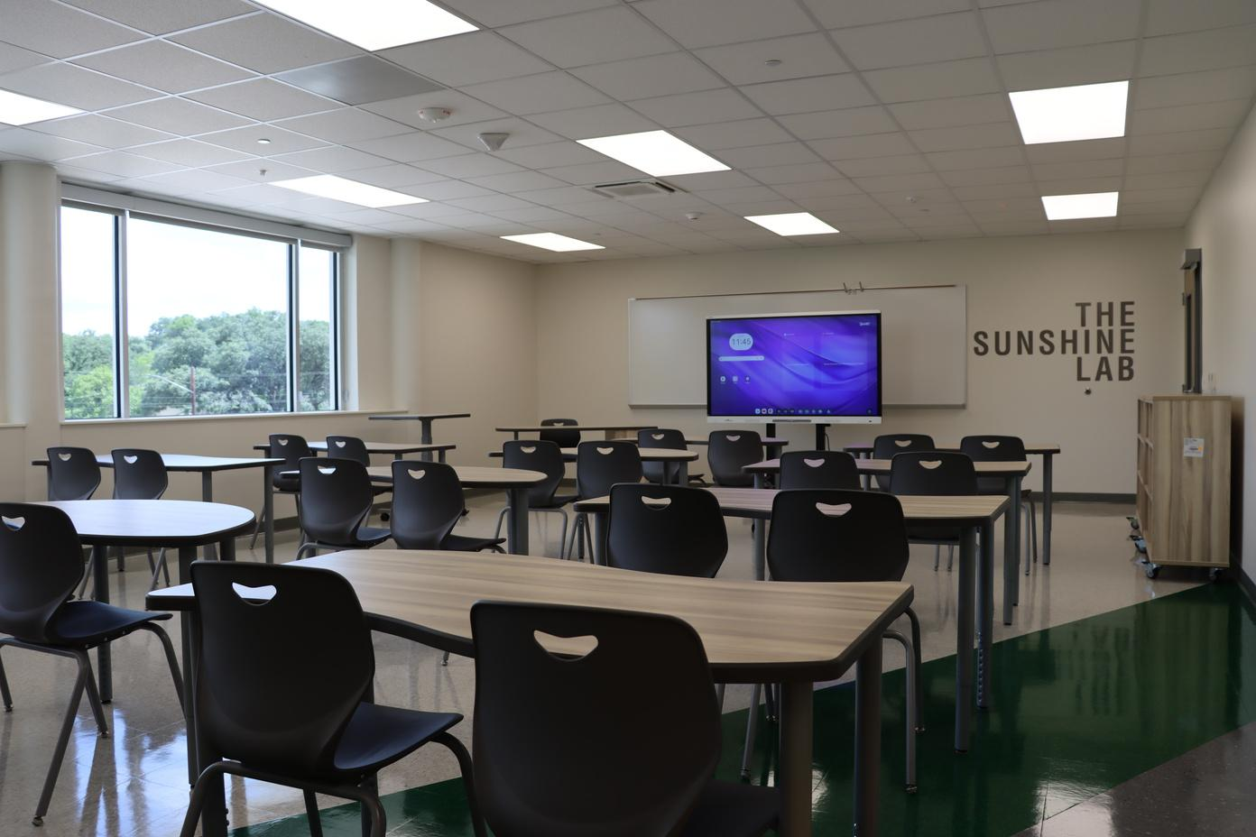
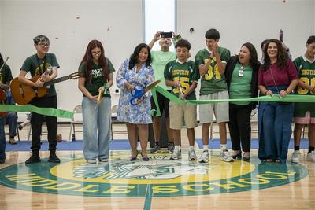
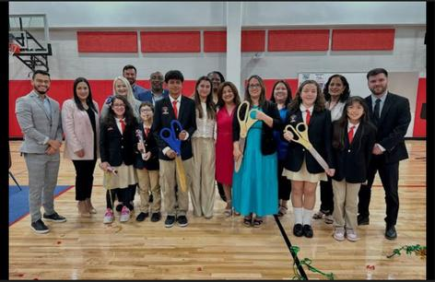
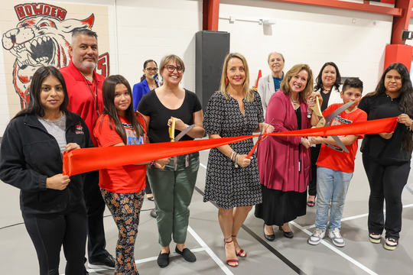
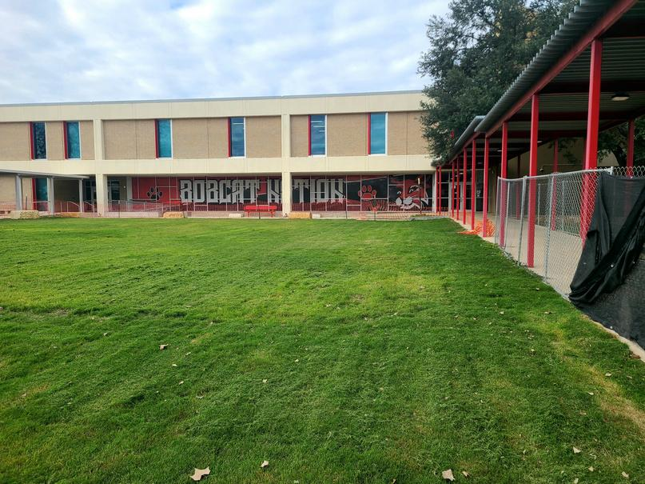
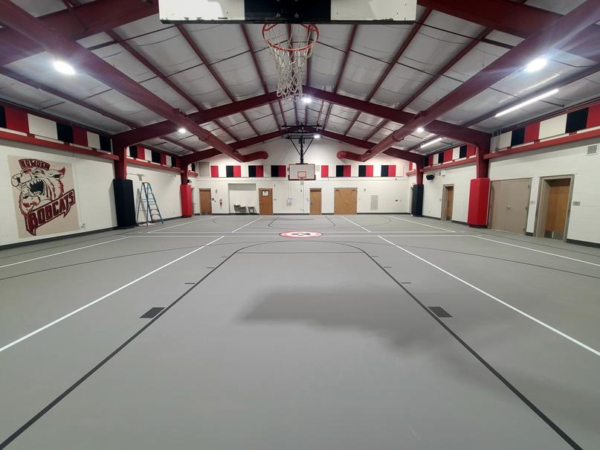
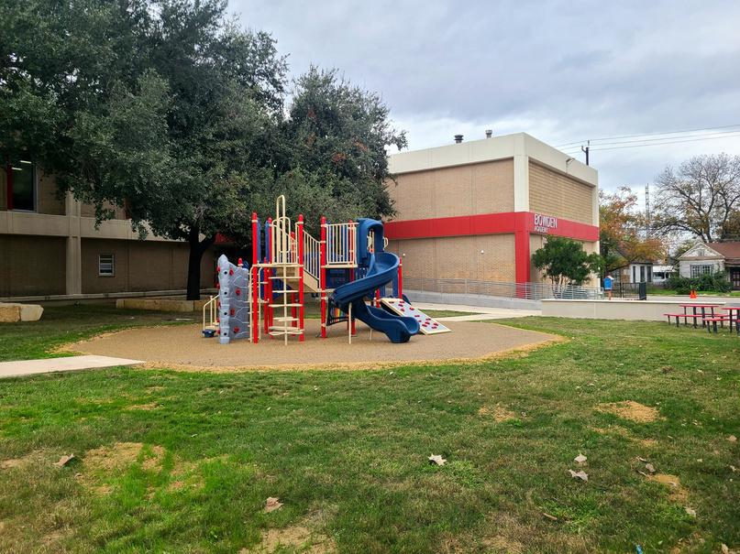
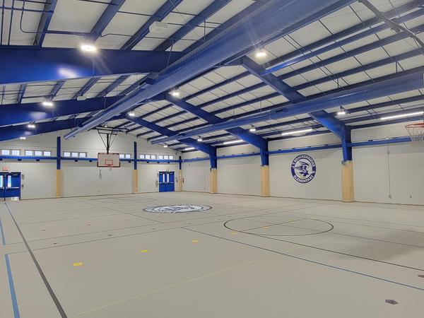

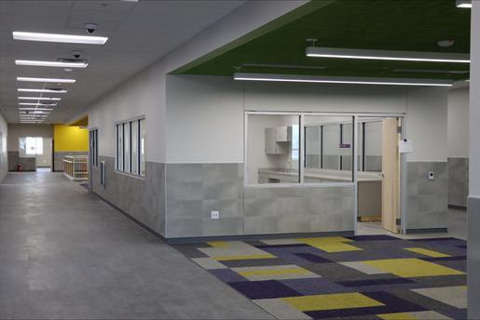
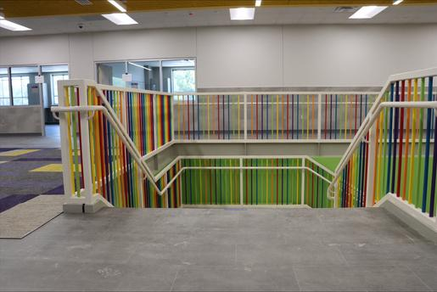
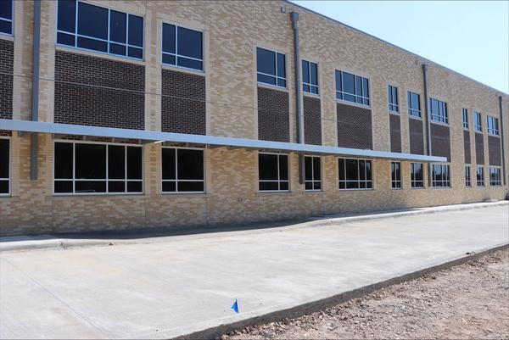
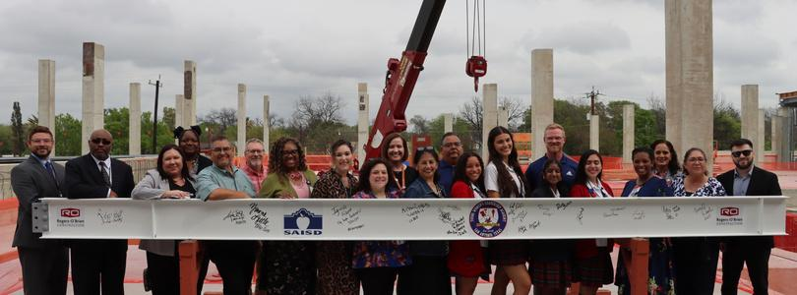
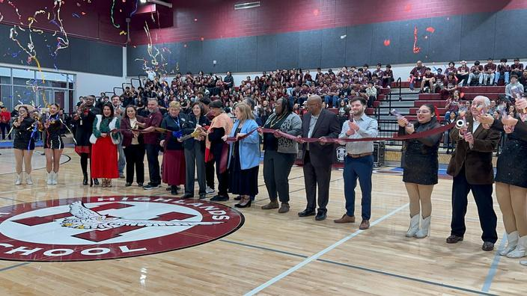
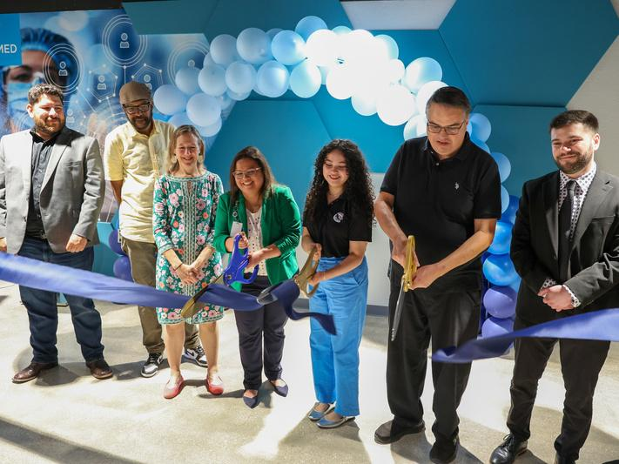
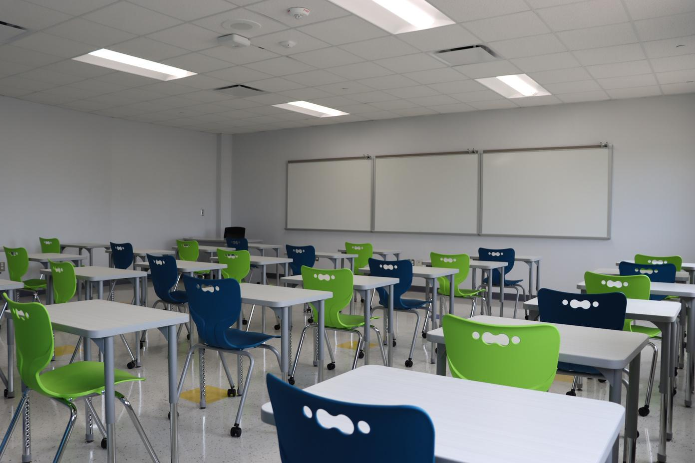
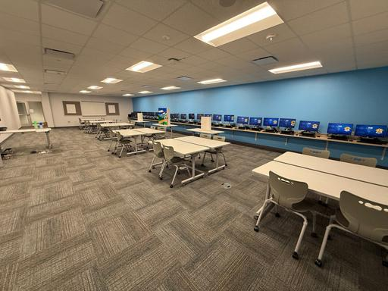
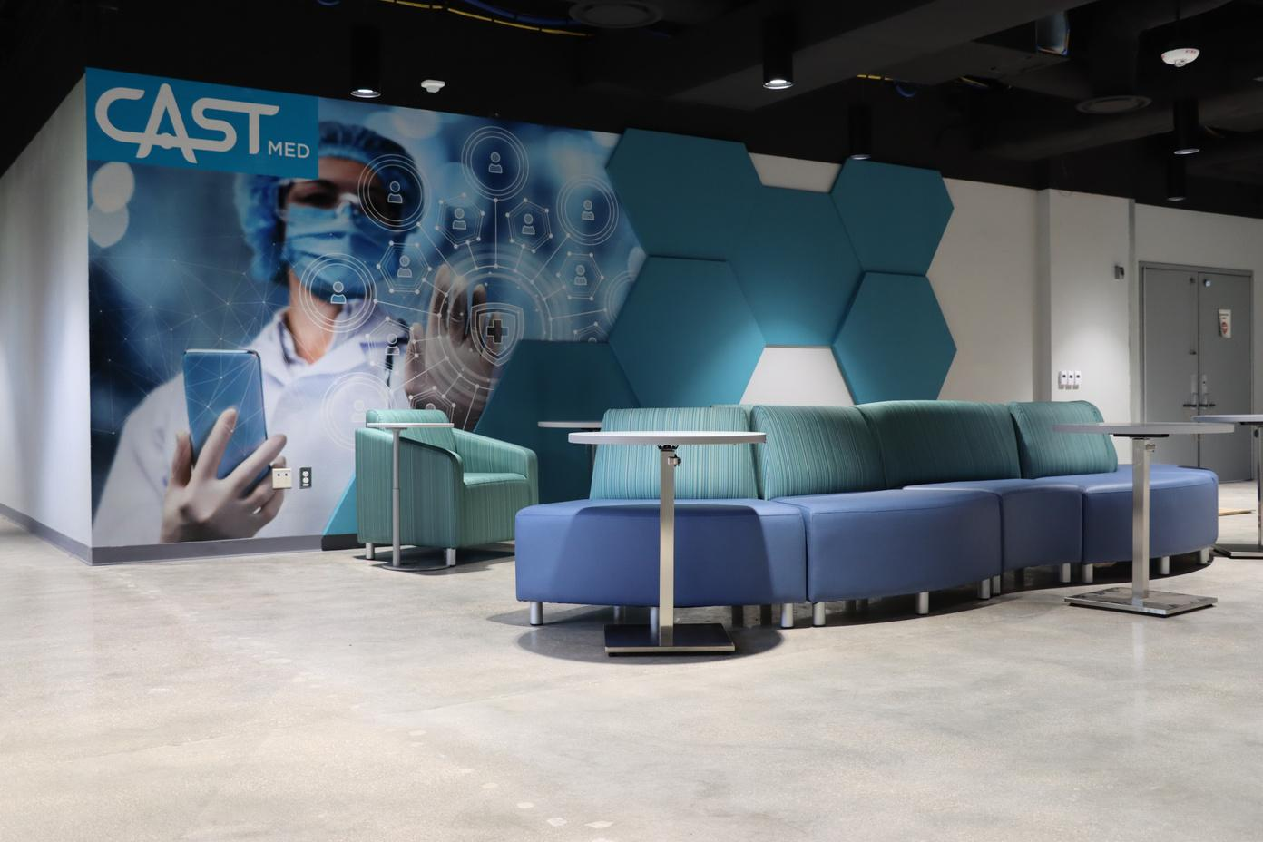
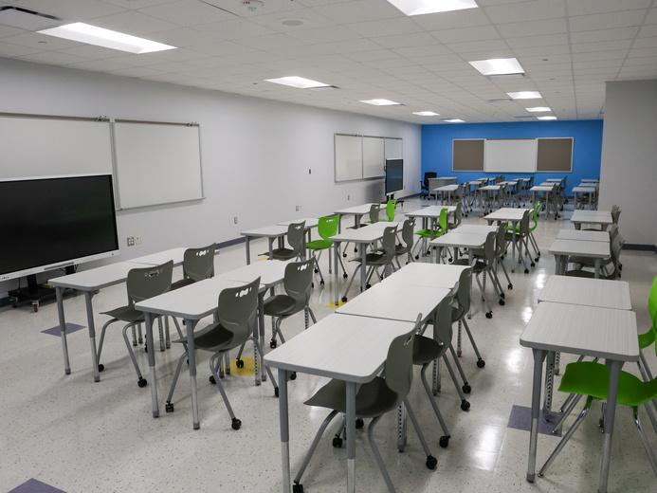
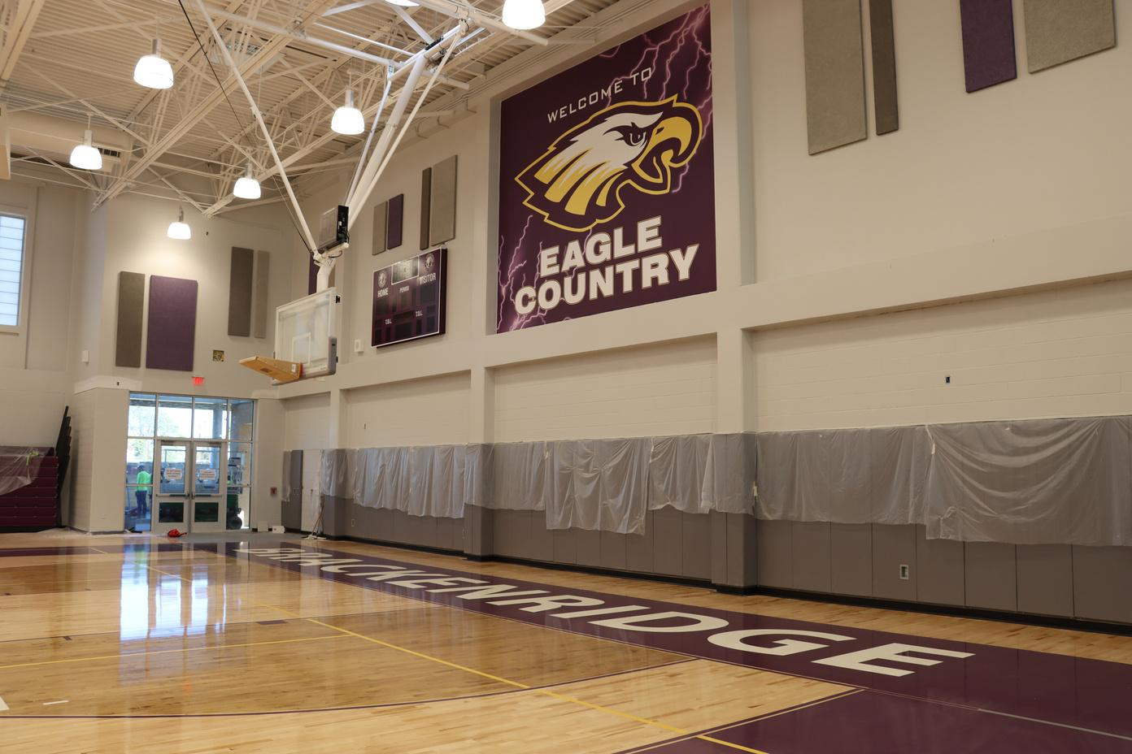
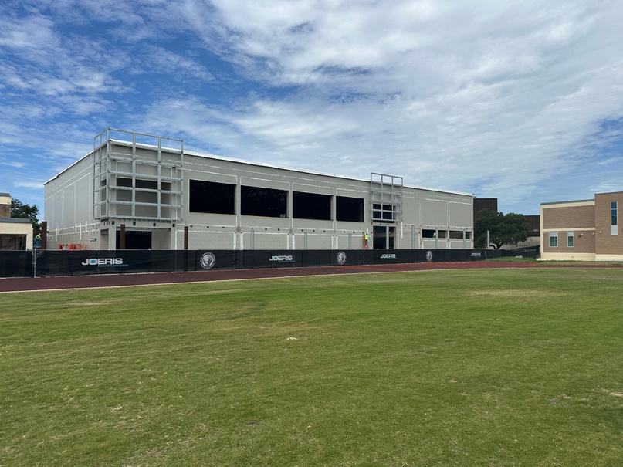
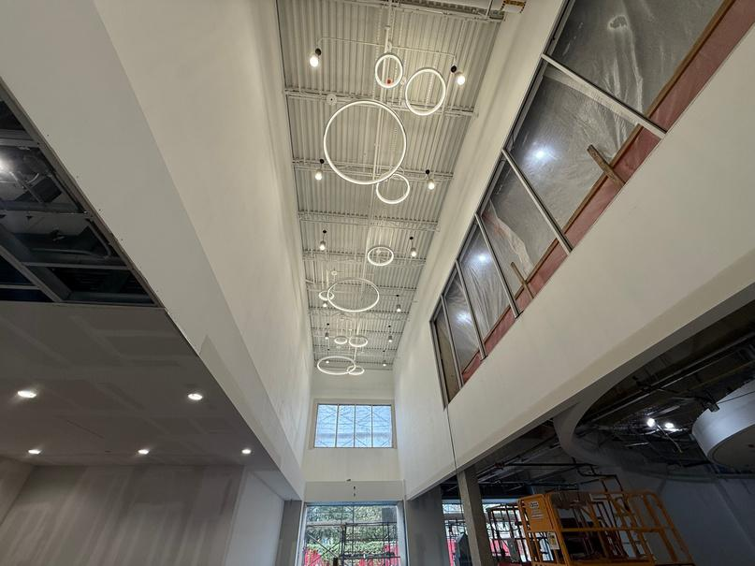
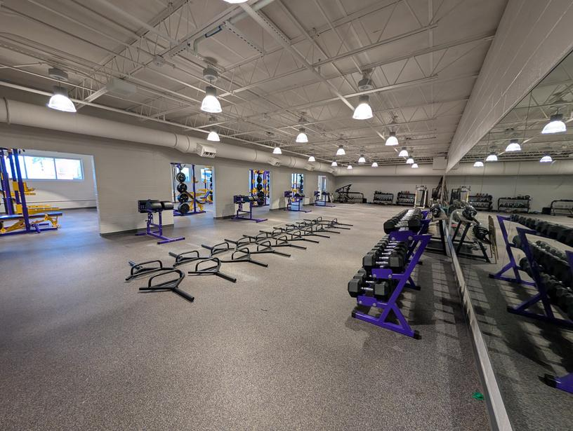
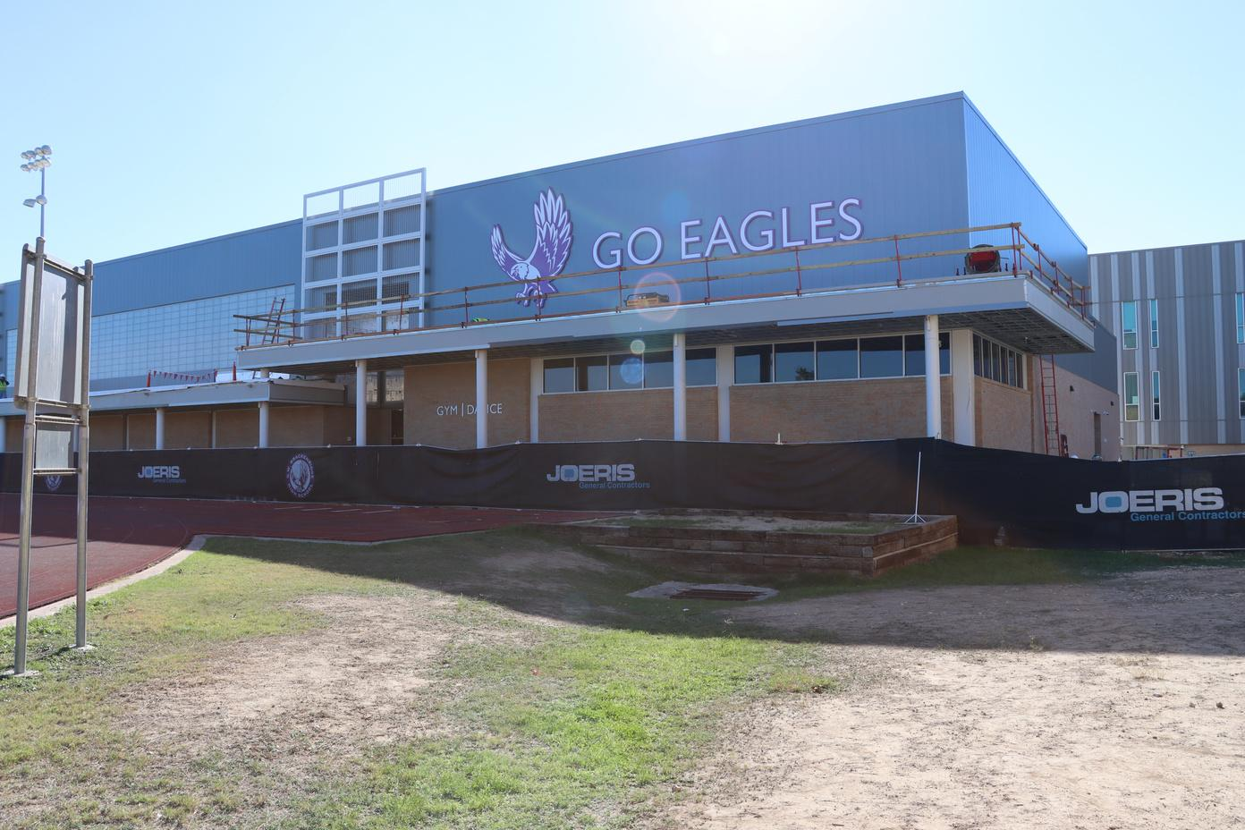
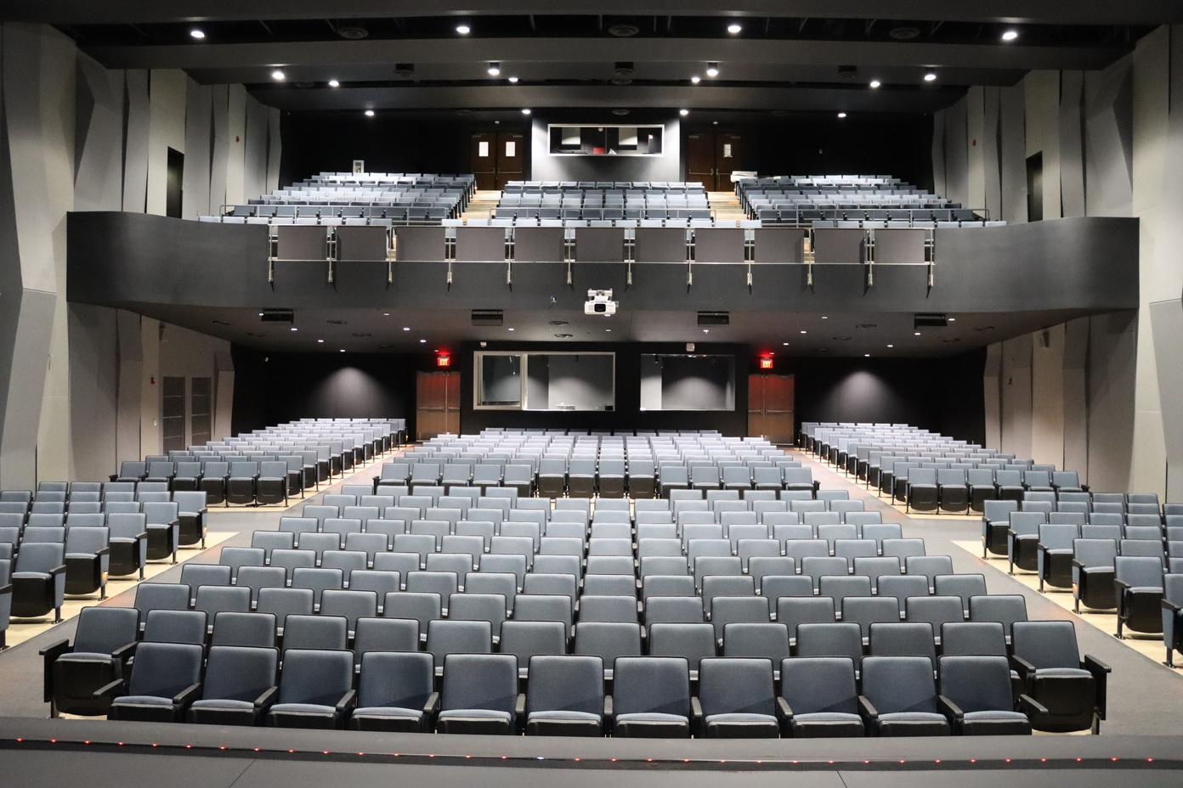
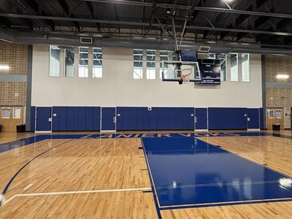
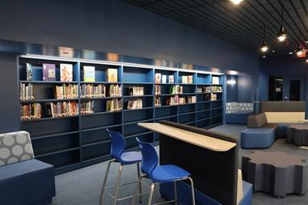
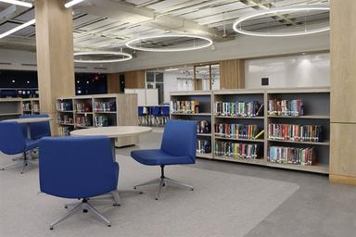
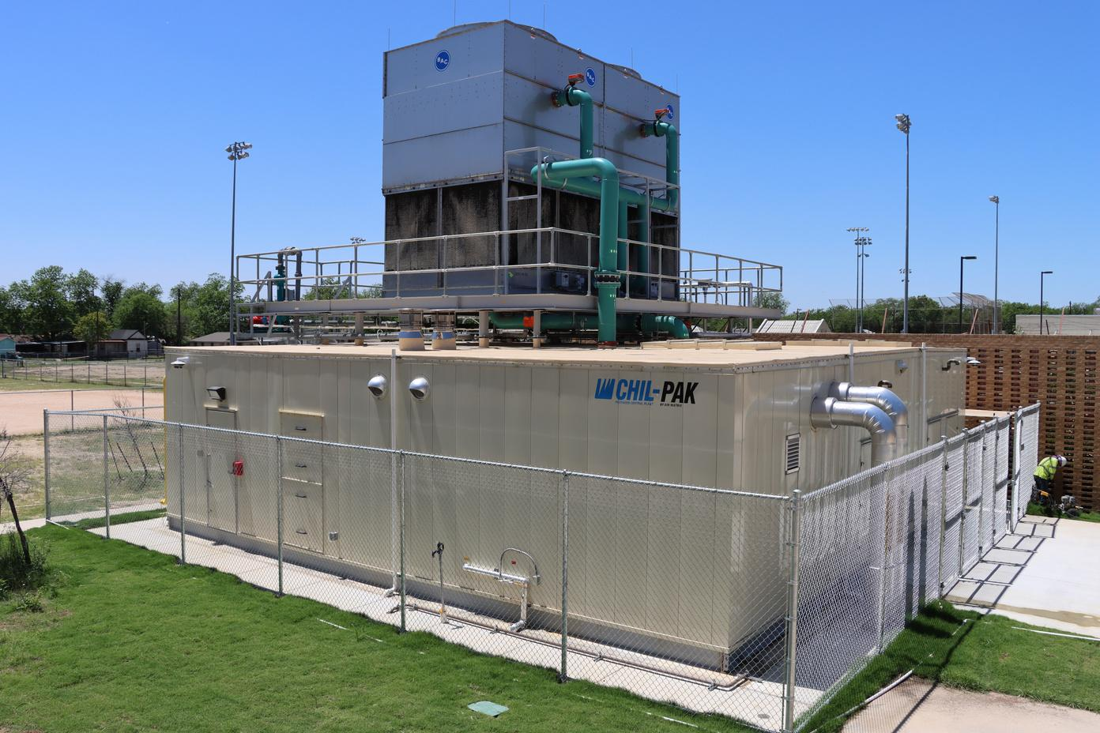

SAN ANTONIO INDEPENDENT SCHOOL DISTRICT
BOND
2020
OVER 100 PROJECTS COMPLETED!

Slide 8




Bond 2020 Project Updates
Programming
Design
Under Construction
Complete
Bonham Expansion
Neal
Rhodes/Carvajal
Collins Garden ES
Steele @ Forbes
ALA at Euclid
HS Sports Fields
Smith ES @ Miller
Madison ES @ Huppertz
Jefferson HS
Longfellow MS Phase 2*
Sam Houston HS
Fox Tech HS
Schenck ES
Graebner ES Phase 2*
Davis MS
Highland Hills ES
ML King Academy
Burbank HS
YWLA Secondary*
HVAC Support Chillers
Lowell (Kelly Academy)
Highlands Central Plant
Safety & Security Upgrades
HVAC Multi Campus
* Some phases are complete or soon to be complete.
Bowden Academy
JT Brackenridge ES
Longfellow MS Phase 1*
HVAC Chiller & Boiler Replacements Phase 1 (29)
Safety & Security Upgrades Phase 1 (58)
Highlands HS
Rogers MS
Edison HS
Irving DLA
CAST Med Academic Renovations
Lanier HS
Graebner ES Phase 1*
Tafolla MS *
Brackenridge HS *
Foster (Schenck @ Foster)
Woodlawn Hills (Port. Rep.)
Ball (Portable Replacement)
Japhet Site Leveling
Reviewing feasibility of site location for project enhancement.
All projects currently in design, are planned to be under construction by Q1 of 2027
3
5
16
104
Projects in bold represent original bond 2020 projects
Notes:
This diagram reflects all of our current projects in their current stage or progression. During programming, Scope goals are identified. In the Design phase, Scope is developed into construction documents.
Of course, during the Under Construction phase, the scope is executed leading up to the completion when areas are turned over to the end user. The top 4 projects on the design list will be transitioning to “Under Construction” within the next 30 - 45 days. We are on track to have the remaining projects under construction within the next 16-18 months. Market conditions and phasing drive when a project can start construction. Major moves typically happen over the summer so that we cause the least disruption to the educational environment.

Slide 9
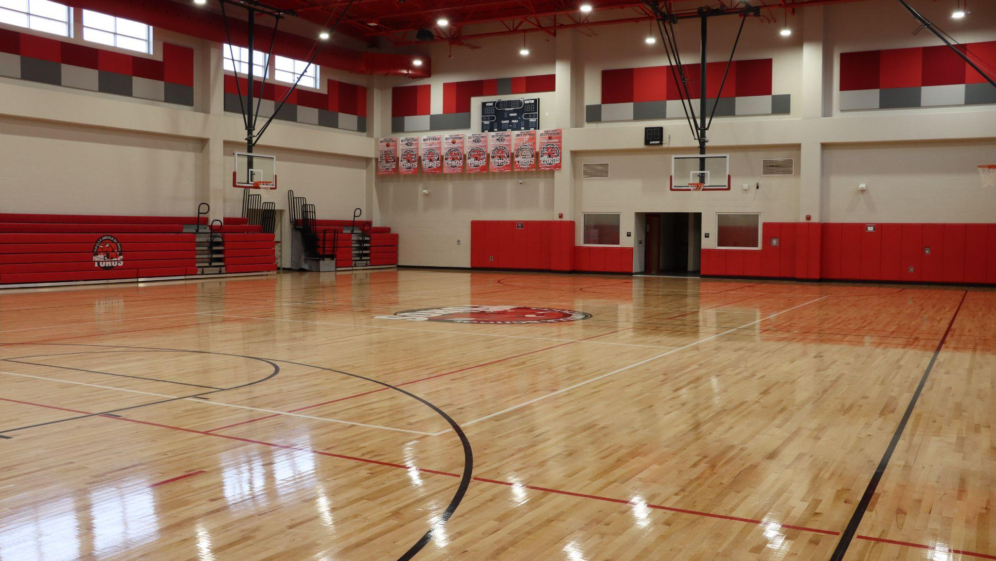
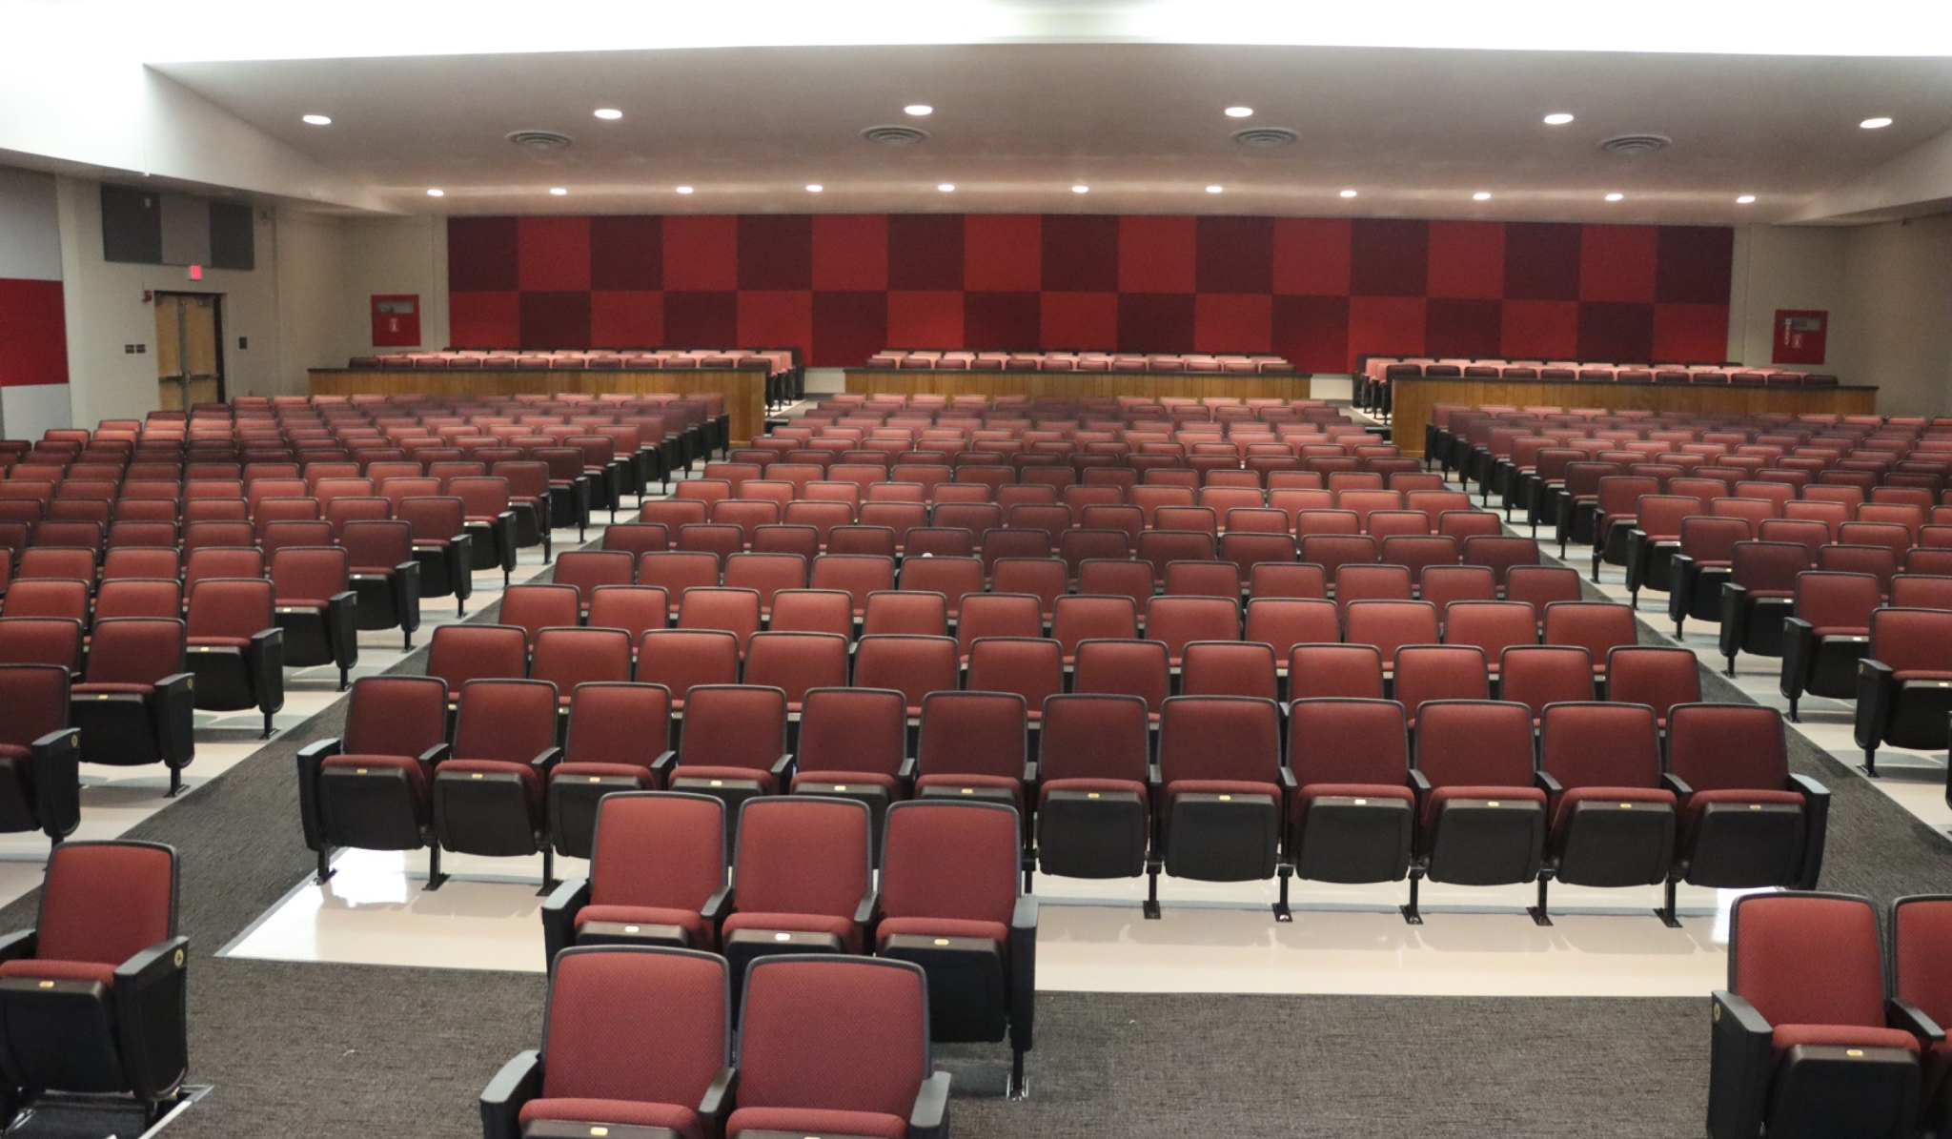
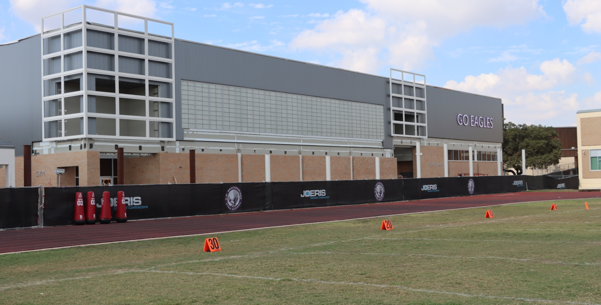
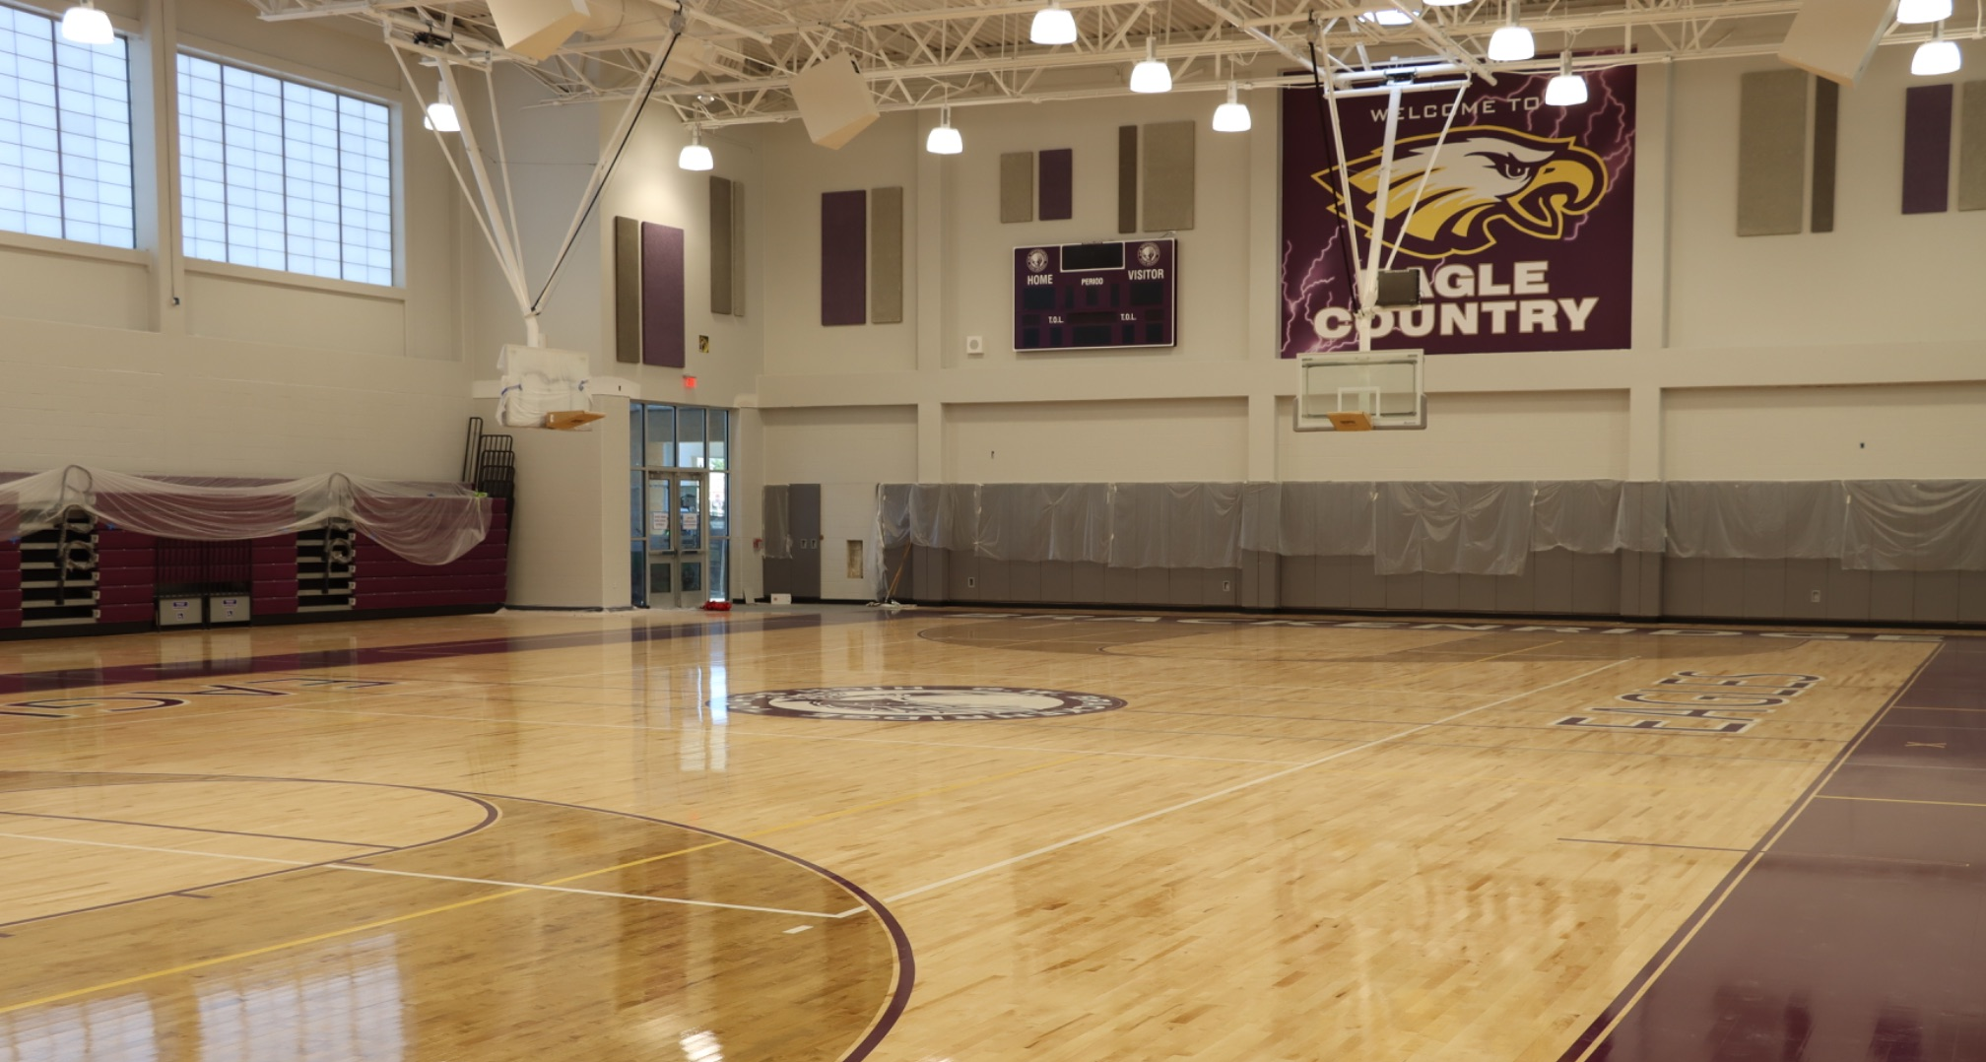
Completed Projects
Bowden Academy
JT Brackenridge ES
HVAC Chiller & Boiler Replacements Phase 1 (29)
Safety & Security Upgrades Phase 1 (58)
Highlands HS
Rogers MS
Edison HS
Irving DLA
CAST Med Academic Renovations
Lanier HS
Graebner ES Phase 1*
Tafolla MS *
Brackenridge HS *
Foster Temporary Expansion
Woodlawn Hills Modular Classroom Installation
Ball Portable Installation
Japhet Site Leveling
Lanier HS
Tafolla MS - Gym
Tafolla MS - Auditorium
Brackenridge HS - Gym
Brackenridge HS - Gym

Slide 10
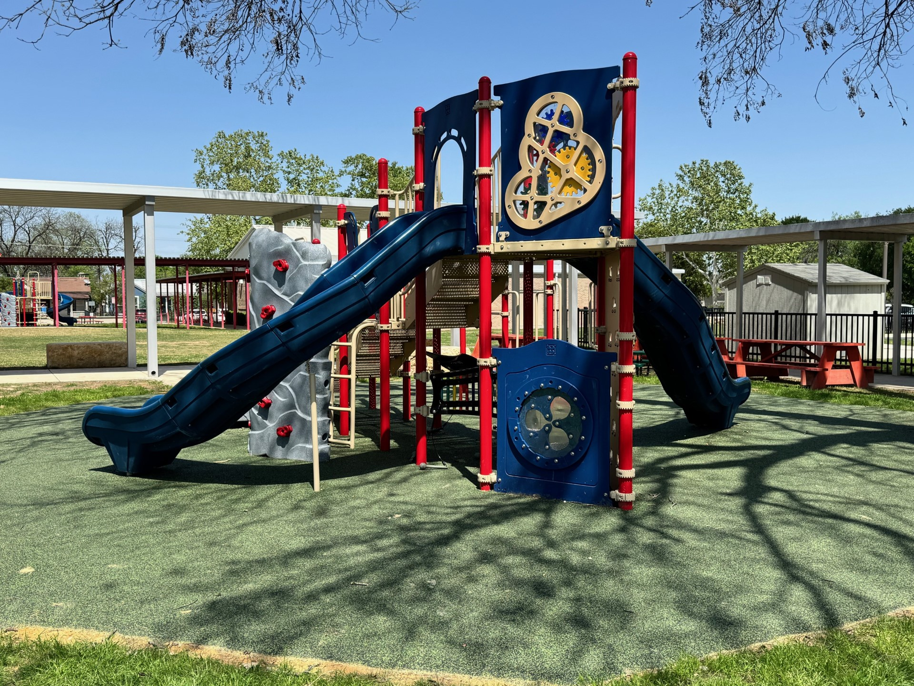
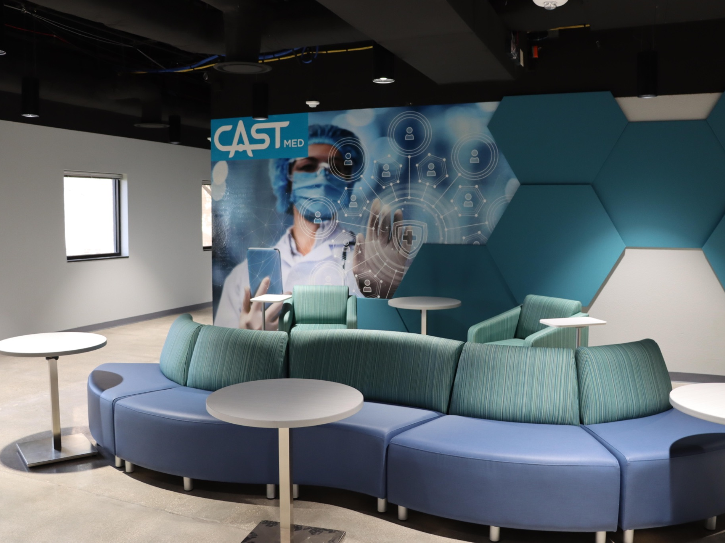
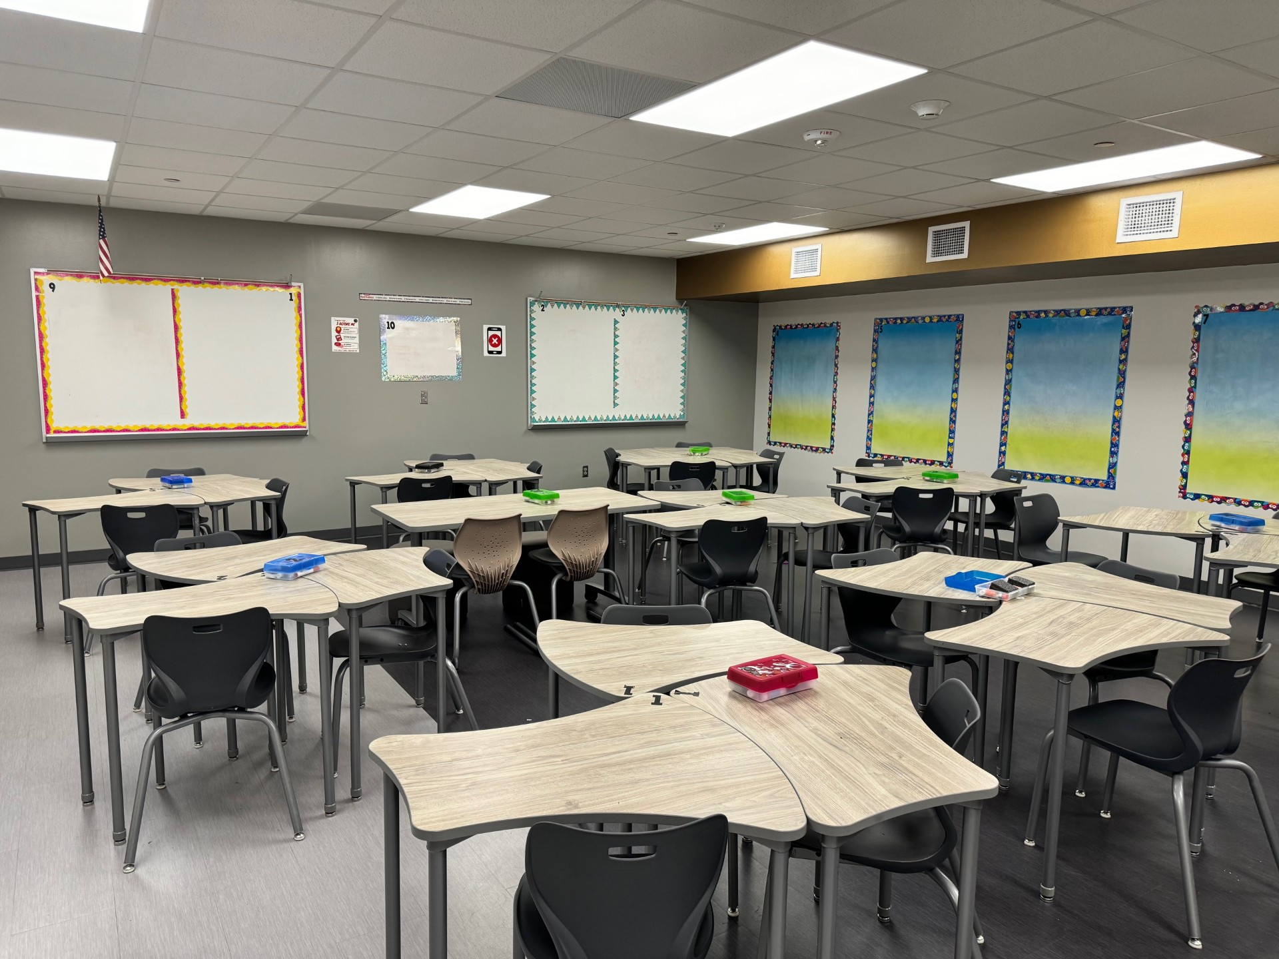
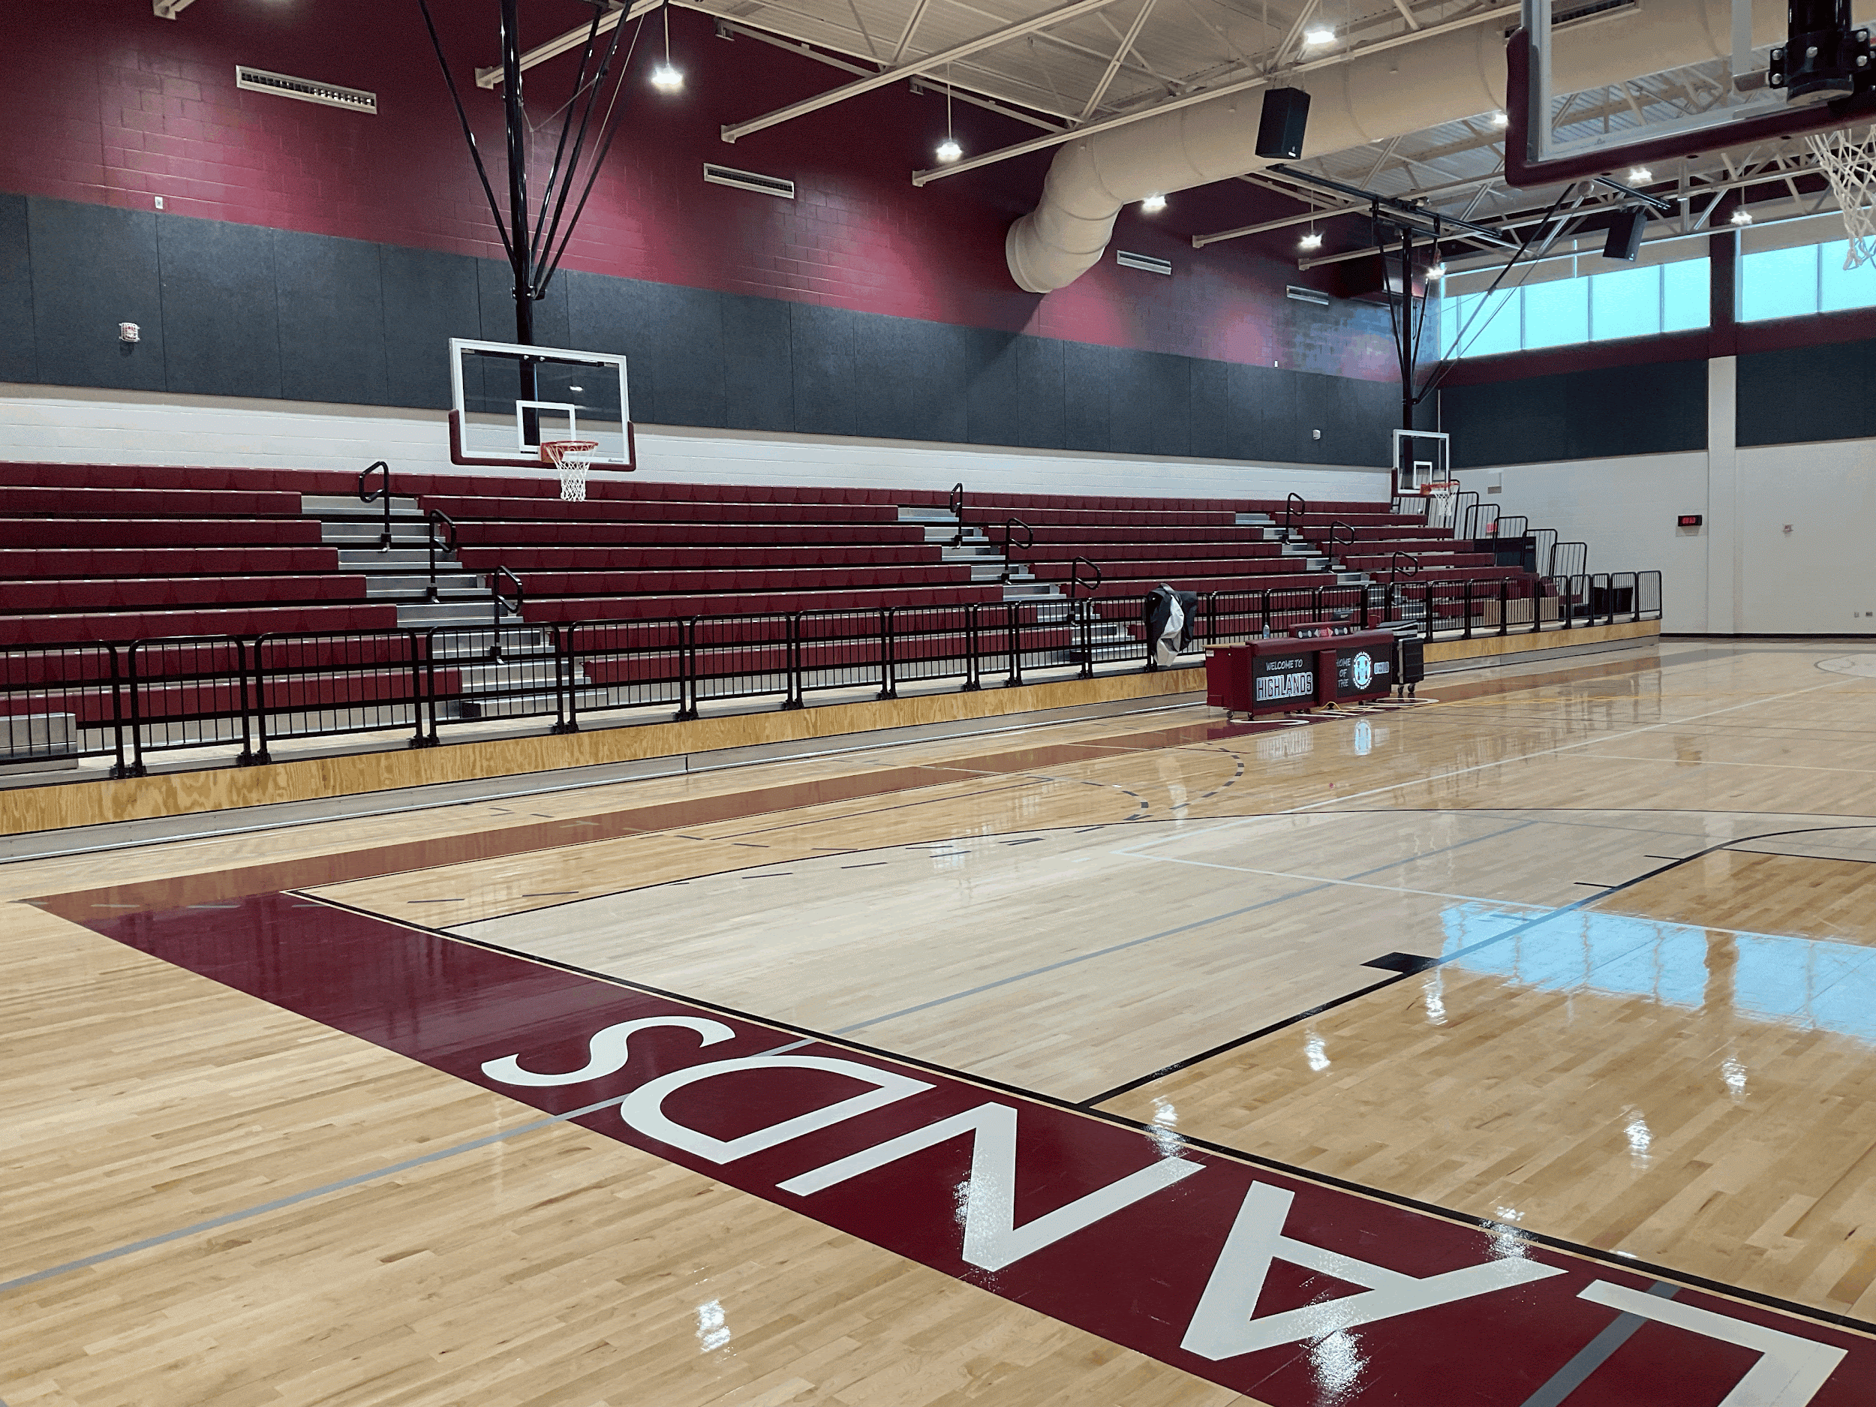





Completed Projects
Bowden Academy - Playground
CAST Med - Foyer
Edison HS - Classroom
Highlands HS - Gym
Irving DL Academy - Gym
JT Brackenridge ES - Flagpole Plaza
Lanier HS - Library
Longfellow MS - Classroom
Rogers MS - Gym

Slide 11



Upcoming Completions
Young Women’s Leadership Academy - Summer 2026
Schenck ES - Summer 2026
Jefferson HS - In Progress

Slide 12




Projects Under Construction
Jefferson HS
Longfellow MS*
Sam Houston HS
YWLA Secondary*
Fox Tech HS
Schenck ES
Graebner ES*
Davis MS
Highland Hills ES
ML King Academy
Burbank HS GYM
HVAC Support Chillers
Lowell (Kelly Academy)
Highlands Central Plant
Safety & Security Upgrades
HVAC Multi Campus
Jefferson HS
YWLA
Schenck ES
Fox Tech HS

Slide 13








Under Construction
Burbank HS - Gym
Davis MS - Gym
Fox Tech HS - Gym
Graebner ES - Academic Building
Highland Hills ES - Academic Building
Longfellow MS - Academic Building
MLK Academy - Demolition
Sam Houston HS - Athletics

Slide 14



Project Photos (Under Construction)
Highland Hills ES
Academic Building
Fox Tech
Fine Arts Building
Sam Houston HS
Gallery

Slide 15




Fox Tech Archaeological Discovery
San Antonio history was uncovered during the Bond 2020 construction on the Fox Tech Campus
Remnants of 1800s homes made of limestone and San Pedro Acequia discovered
Documentary is available on SAISD’s Youtube account and SAISD Bond Website
Discovery gained coverage by Smithsonian, San Antonio Report, & San Antonio Current
San Pedro Acequia
Mayor Newton’s
House Remnants
Mayor Newton’s
House Rendering
Limestone House Remnants

Slide 16



Highlands High School Central Plant Overhaul
Includes: 7 new chillers and 5 new boilers.
Updates include changes to the electrical, piping, plumbing, and controls

Slide 17






Project Photos (In Design)
ALA Euclid
Steele Montessori Academy
Smith @ Miller ES
MLK Academy
Collins Garden ES
HS Sports Fields

Slide 18




Recent Celebrations
Burbank Groundbreaking Ceremony (January 13) - Honored the start of demolition and rebuild of the old Burbank Gym. Featured guest appearances from Senator José Menéndez & Councilwoman Teri Castillo.
MLK Academy Last Look (January 19) - Unveiled new academy design during the convocation speeches at the MLK March.
Lanier Ribbon Cutting Ceremony (February 18) - Celebration of recently completed renovations to auditorium and library.
Tafolla Ribbon Cutting Ceremony (March 19) - Celebration of recently completed renovations to auditorium and athletic spaces and athletics grant provided by HEB and Kellogg’s
Burbank HS Groundbreaking Ceremony
MLK Academy
Last Look
Lanier HS
Ribbon Cutting Ceremony
Tafolla MS
Ribbon Cutting Ceremony

Slide 19




Beam Signing Ceremonies
Honors final beam being installed to new construction buildings.
Fox Tech Campus (April 17) & Highland Hills Elementary (April 28) both celebrated this milestone in April.
Fox Tech Beam Signing Ceremony
Fox Tech Beam Signing Ceremony
Highland Hills ES Beam Signing Ceremony
Highland Hills ES Beam Signing Ceremony

Slide 20




Recent Community Meetings
Bond 2020 Q4 Community Update Sessions (December 10 & December 18) - Hosted four virtual community meetings for staff, families, and the broader community to provide an update on Bond 2020 projects and key operational developments.
Madison Elementary Community Meeting (January 22) - Discussed potential move to Huppertz with community
Steele Montessori Academy Community Meeting (January 29) - Provided update on Steele project to community
Collins Garden Elementary Community Meeting (February 5) - Discussed potential campus changes to community
Bonham Academy & Primary Community Meeting (March 26) - Provided project updates to both Bonham Campuses and received community feedback
Madison ES
Community Meeting
Steele Montessori
Community Meeting
Collins Garden ES
Community Meeting
Bonham Relief
Community Meeting

Slide 21
Our Future
Notes:
Now that an overview of bond 2020 has been provided, we would like to discuss the need for future bonds.

Slide 22

Our Condition 5-Year Renewal Forecast
Capital improvements initiated under the 2020 Bond program will address current infrastructure needs, though a significant balance will persist.
Based on the current facility portfolio, an additional $781 million in capital life cycle needs will emerge by 2028.
This figure is subject to increase if preventative maintenance protocols are not consistently funded and implemented.
$800 M
$600 M
$400 M
$200 M
$0
Notes:
Bond 2020 will address current infrastructure needs. However, our current projections indicate an additional $781 million in capital life cycle needs will emerge by 2028. This figure will increase if preventive maintenance is not consistently funded and implemented. This is why the district is positioning itself to go out for a bond in 2026 and why we need regular bond cycles.

Slide 23
Framing the Long-term Vision
of the
NEW WAY FORWARD
Notes:
Now that an overview of bond 2020 has been provided, we would like to discuss the need for future bonds.

Slide 24





The Structural Budget Challenge
Since May 2022, we have identified a structural budget problem driven by root causes that run deep and require years of committed work to fix.
Funding Gap
Enrollment
Excess Capacity
The State of Texas has "flat-funded" schools for 6 years, while the cost of living rose by 22%.
A 25-year history of declining enrollment due to demographic shifts.
We operate thousands more "seats" than students. While we took significant steps to correct this issue, we are still slow to reduce our footprint.
Policy changes like vouchers and insufficient funding increases worsen this gap.
This trend has persisted despite our regional-leading strategy to recapture lost enrollment.
Structural problems aren't fixed by one year's cuts. They require a long-term strategy.
and…

Slide 25

The Complexity of a Legacy Infrastructure
Operating a district with an average building age of 63 years presents unique challenges beyond simple repairs and preventative maintenance.
Systemic Obsolescence: Sourcing parts for 60-year-old systems (HVAC, plumbing) is often impossible, requiring costly custom fabrication.
Energy Inefficiency: Uninsulated masonry and single-pane windows create massive energy waste compared to modern standards.
Modernization Barriers: Retrofitting for HVAC, ADA, specialized classrooms, and modern security is often structurally invasive, cost-prohibitive, or not simply possible.

Slide 26




Our Historical Response
For decades, our strategy has been to patch, repair, and renovate buildings. With aging infrastructure, this is no longer financially viable.
SAISD Campus Age
63 Years Old: Average building age demands constant, expensive maintenance.
Cost Inefficiency: Repairing aging structures often costs significantly more than building new.
The "Churn": Continuing to move students between old buildings avoids the root cause of the infrastructure deficit.

Slide 27

Rightsizing as a Response
November 2023

Slide 28
Our Rightsizing Reality
2024-2025 Enrollment & Campus Options
Grade Group | Number of Students | Number of Current Campus Options | Ideal Campus Enrollment | Number Needed Based on Ideal | Number of Campuses with FC>=Ideal | Current Average (MED) Campus FC
PK-5 | 22,578 | 49 | 700 | 32 | 18 | 597 (610)
6-8 | 8,361 | 28 | 1,000 | 9 | 4 | 767 (716)
9-12 | 13,137 | 17 | 1,400 | 9 | 7 | 1,433 (1745)
Total | 44,076 | 86 |  | 50 | 29*
* The District needs an additional 21 buildings or renovations to meet the ideal campus size based on enrollment.

Slide 29

A Strategic Shift: The New Way Forward
29

Slide 30

Shift Investment Priorities
The "New Way Forward" shifts investment from maintaining empty hallways to funding academic excellence.
Build New: Constructing fewer, larger, state-of-the-art facilities
Consolidate: Closing older, inefficient schools at the conclusion of construction to concentrate resources
30

Slide 31

Focus on Three Organizing Elements
The New Way Forward will focus on three organizing elements:
Student Success
Community Benefit
Strengthening District Identity
1
2
3
31

Slide 32







New Budget Trajectory
The New Way Forward directly transforms critical budget challenges.
Facilities Maintenance
Staffing & Vacancies
Academic Performance
Replacing 63-year-old infrastructure eliminates excessive emergency repair costs.
Consolidated campuses allow for optimized staffing, reducing vacancies.
Stronger programs and modern environments correlate with improved outcomes.
Technology Access
Compensation
Curricular & Extracurricular Alignment
New construction ensures high-speed connectivity
Operational savings are reinvested into competitive salaries to retain top talent.
Larger student bodies enable robust offerings at every campus.
32

Slide 33





Blue Ribbon Task Force
The Blue Ribbon Task Force is actively meeting to discuss a future capital improvement program.
Notes:
The Blue Ribbon Task Force have concluded their 2025 sessions this week! The team spent their last meetings of the year deliberating on a recommendation for the board that will best serve SAISD.
The Blue Ribbon Task Force was assembled in October 2025 to inform and advise board and district leadership on how to achieve its vision of families choosing SAISD schools because they see their values, culture, and aspirations reflected. Over the course of 14 meetings, the task force visited campuses, learned about operational life cycles, and provided feedback on how the district can address its facility needs, ensuring all students have access to modern, inspiring, and equitable learning environments.
They plan to make their recommendation to the board in 2026.

Slide 34



Citizens Bond Advisory Committee
Interested in joining the committee? Use the QR Code to submit an application.
The Citizens Bond Advisory Committee purpose is to inform and advise the Board in matters relating to Bond 2020. Committee members also provide feedback to District staff and review progress reports.

Slide 35





Stay Connected
For additional information on bond projects and upcoming events, please visit our website: SAISD.Net/O/Bond and follow @SanAntonioISD on Facebook, Instagram, and LinkedIn.

Slide 36
Questions & Answers
Notes:
Please submit your questions within the chat. We will

