Slide 1






Transparency and Attribution
Badge System
“Giving Credit Where Credit is Due”

Slide 2
SSUSD’s AI Transparency Badge System
In today's classroom, where AI can assist in creating all kinds of work, it's very important to be clear about how we use it. SSUSD’s AI Transparency System provides a simple way to show others how you used AI to help you in your work.
It's a simple way to show others how you used AI to help you in your work.
Here's what it does:
It helps you tell people if and how you used AI in your work.
By using these badges, you're being honest about your creative process. This is a way to show that you're responsible when using AI and that you are acknowledging that you used AI in your creative process.

Slide 3

How to Add Your AI Transparency Badge
Look at the badges below and think about how much AI helped you with your assignment.
Choose the badge that best matches your AI use.
Download your badge. Paste the badge to your work. You can put it on your:
Your document
Your slideshow
Your website
Your video
Any other type of assignment
All HI 0% AI
Assist Up to 20%
Integrate Up to 40%
Collaborate Up to 60%
AI Agency Up to 100%
Notes:
Link to download individual AI Badges for use with assignments: https://drive.google.com/drive/folders/1mLqIFPpRqXIGwfNqPCyNVRee1R2c96JT?usp=sharing

Slide 4
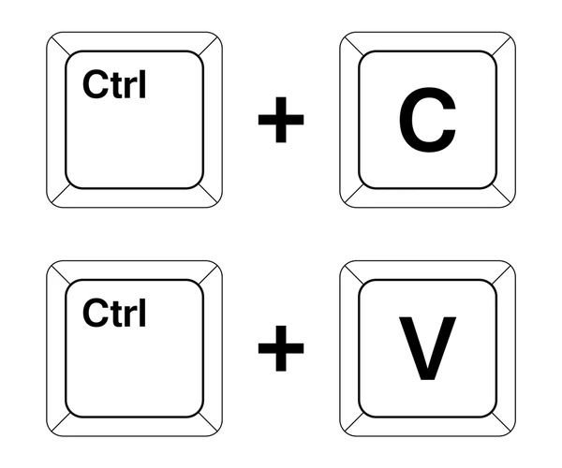
How to Add Your AI Transparency Badge
Look at the badges below and think about how much AI helped you with your assignment.
Choose the badge that best matches your AI use.
Copy that badge. Paste the badge to your work. You can put it on your:
Your document
Your slideshow
Your website
Your video
Any other type of assignment
All HI 0% AI
Assist Up to 20%
Integrate Up to 40%
Collaborate Up to 60%
AI Agency Up to 100%
COPY
PASTE

