Slide 1
Did you know…
Cumberland Regional
has been selected as the
1st High School of Business
site in New Jersey ?
Notes:
(For dramatic effect, don’t speak during this slide)

Slide 2
OK, let’s back up.
Notes:
2
(For dramatic effect, don’t speak during this slide)

Slide 3

Just what is
High School of Business™ anyway?
By MBAResearch
Notes:
3
(For dramatic effect, don’t speak during this slide)

Slide 4

High School of Business™
By MBA Research
National business & marketing program
Did you know…
Prepares you to excel in college
business administration programs
Notes:
High School of Business is only available in selected schools nationwide
Designed like a college business and marketing program with the goal of preparing you to excel in a college business administration program. So is High School of Business for you? Have you ever thought that you… (next slide)

Slide 5
By MBA Research
So, is
High School of Business™
for you?
Notes:
(go to next slide)

Slide 6

Might major in business
in college?
By MBA Research
Marketing?
Finance?
Accounting?
Management?
Advertising?
Notes:
6
(go to next slide)

Slide 7
By MBA Research
Then
High School of Business™
might be for you!
Notes:
(go to next slide)

Slide 8
Enjoy being challenged and having fun?
By MBA Research
Like organizing groups of people
or activities?
Want to own a business someday?
Get a Masters of Business Administration (MBA) on down the road?
Notes:
8
(go to next slide)

Slide 9
Here’s how it works…
Notes:
The program has six required courses. In each course, you’ll focus on an area of business administration by working on real problems that business executives face each day.

Slide 10
Series of six courses
In each course
you will…
Principles of Business
Business Economics
work on real
business projects
Principles of Marketing
Principles of Finance
learn about the different areas
of business
Principles of Management
Business Strategies
Take them in this order.
Notes:
10
The program has six required courses. In each course, you’ll focus on an area of business administration by working on real problems that business executives face each day.

Slide 11
But High School of Business™
has a twist. It’s called
Project-based learning
Notes:
Project-based learning challenges you to learn as you work on projects.
In your teams, you will work together to complete the project. That means using your creativity to come up with new ways to get the job done. There’s no one right answer to the projects. Instead, each team in your class could come up with a completely different solution to the problem. Here’s an example of one of the projects in the High School of Business program’s Business Economics course…

Slide 12

But High School of Business™ has a twist. It’s called
Project-based learning is…
Learning as you solve real business problems
Taking charge of your education
You will
Work in teams of 3-4
Be given a business problem to solve
Organize team to get the work done
Find a solution
Present your findings
Notes:
12
Project-based learning challenges you to learn as you work on projects.
In your teams, you will work together to complete the project. That means using your creativity to come up with new ways to get the job done. There’s no one right answer to the projects. Instead, each team in your class could come up with a completely different solution to the problem. Here’s an example of one of the projects in the High School of Business program’s Business Economics course…

Slide 13
Here’s an example…
Notes:
(silence at first as question is displayed on the screen)
Projects like these give you the chance to be in charge.
You’ll do real interviews,
you’ll get information and learn new concepts through internet research,
you’ll get creative to come up with the best possible plan.
And then you’ll share your ideas and results with business professionals.
Each High School of Business course includes several projects. You’ll learn new things as you work on challenging– but fun-- projects.

Slide 14
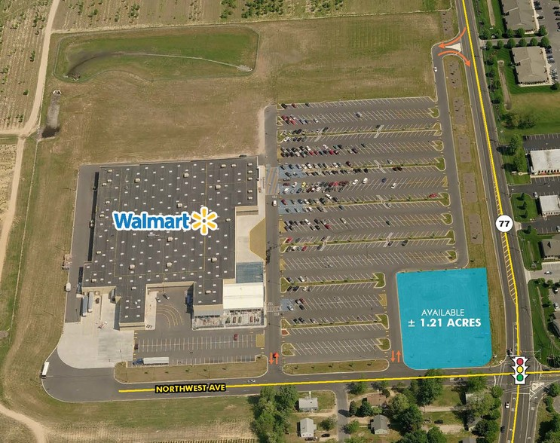
Question: How can a vacant lot be put to best use?
Using a real vacant lot in your town, your team will
Investigate zoning
Interview local citizens
Do Internet research
Develop creative ideas
Make an informed decision
Present your idea to Chamber
of Commerce
Notes:
14
(silence at first as question is displayed on the screen)
Projects like these give you the chance to be in charge.
You’ll do real interviews,
you’ll get information and learn new concepts through internet research,
you’ll get creative to come up with the best possible plan.
And then you’ll share your ideas and results with business professionals.
Each High School of Business course includes several projects. You’ll learn new things as you work on challenging– but fun-- projects.

Slide 15
So, what’s the big deal about
High School of Business™ ?
Make it real
By MBA Research
Work on real projects
Solve real business problems
Be challenged
Warning—your brain will hurt!
Fast-paced courses
Tackle projects similar to college and career
Notes:
So what’s the big deal? Here’s the big deal about High School of Business:
-Make learning real by solving real business problems– not just listening to lectures and reading textbooks
-But watch out- you will be challenged. The courses are fast-paced. The projects are based on dilemmas faced by college students and business professionals. But you might not notice how hard you’re working because you’ll be caught up in the excitement of getting the project completed successfully.

Slide 16

So, what’s the big deal about
High School of Business™ ?
Get the Point
By MBA Research
Use your math and English skills
A-ha! An answer to “why do I have to learn this stuff ?”
Notes:
How many times have you been in class or studying when the thought…
“why do I have to learn this stuff?” came into your mind?
High School of Business can answer that for you. To solve business projects, you’ll use math (think about how a company needs to know math to set its prices, pay its employees, put things on sale without losing money). And you’ll definitely use English to give presentations, write business proposals, and put together reports.
(insert your high school’s name here) has made a commitment to you to offer a great education. High School of Business is part of that. We’ve put together a behind-the-scenes team that is working to get you the best possible education and experience. We even have a college professor and business professionals on the team to make sure the High School of Business program is giving you what you need to succeed in college business administration programs.

Slide 17
So, what’s the big deal about
High School of Business™ ?
Your support team
By MBA Research
The High School of Business™
Steering Team at your school
Business executives
College professors
Teachers
School counselors
Principal
Working together to build
the best program for you
Notes:
17
How many times have you been in class or studying when the thought…
“why do I have to learn this stuff?” came into your mind?
High School of Business can answer that for you. To solve business projects, you’ll use math (think about how a company needs to know math to set its prices, pay its employees, put things on sale without losing money). And you’ll definitely use English to give presentations, write business proposals, and put together reports.
(insert your high school’s name here) has made a commitment to you to offer a great education. High School of Business is part of that. We’ve put together a behind-the-scenes team that is working to get you the best possible education and experience. We even have a college professor and business professionals on the team to make sure the High School of Business program is giving you what you need to succeed in college business administration programs.

Slide 18

So, what’s the big deal about
High School of Business™ ?
Make Connections
By MBA Research
Guest speakers from business world
Expert audiences for your team presentations
Short internship experience
High School of Business™ students
from across the country
Notes:
You’ll see those business professionals and others during project presentations and a short internship. They are your connection to the world of business outside of this school.
Another connection you’ll make is with students from across the country who are also in the High School of Business program. Through podcasts, email, and other means of communication, you’ll work with and learn from students in other parts of the US who are working on the same projects as you.
Want to be a step ahead when you get to college? Then High School of Business might be for you. Working on real business projects, using teamwork to get the job done– these are the things you’ll face in college. High School of Business puts you on track to excel in your college business administration program.

Slide 19



So, what’s the big deal about
High School of Business™ ?
Get Prepared
By MBA Research
Business and marketing knowledge
Problem-solving skills
Build confidence
Be ready to excel in your college Business Administration program!
Notes:
19
You’ll see those business professionals and others during project presentations and a short internship. They are your connection to the world of business outside of this school.
Another connection you’ll make is with students from across the country who are also in the High School of Business program. Through podcasts, email, and other means of communication, you’ll work with and learn from students in other parts of the US who are working on the same projects as you.
Want to be a step ahead when you get to college? Then High School of Business might be for you. Working on real business projects, using teamwork to get the job done– these are the things you’ll face in college. High School of Business puts you on track to excel in your college business administration program.

Slide 20
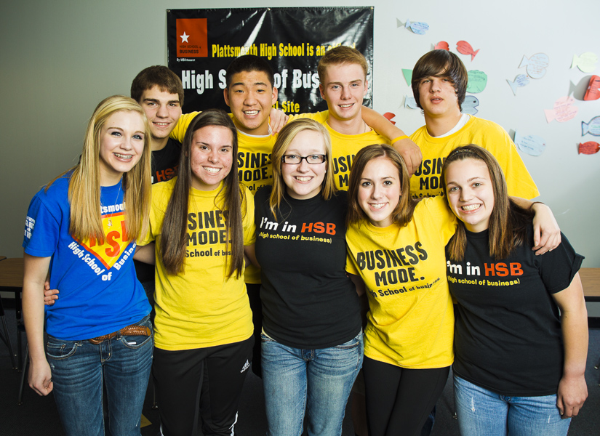
So, what’s the big deal about
High School of Business™ ?
Have Fun!
By MBA Research
What students say about
High School of Business™
“I loved being in charge
of the projects!”
“We really were making
the decisions… I liked that.”
“I look forward to
going to this class.”
Notes:
But don’t take my word for it. Here’s what students from across the country have said about High School of Business.

Slide 21
Interested?
Contact Mrs. Fuller or Mr. Reichardt for more information.
Notes:
(tell students how to get more information about joining High School of Business at your school)

