Slide 1
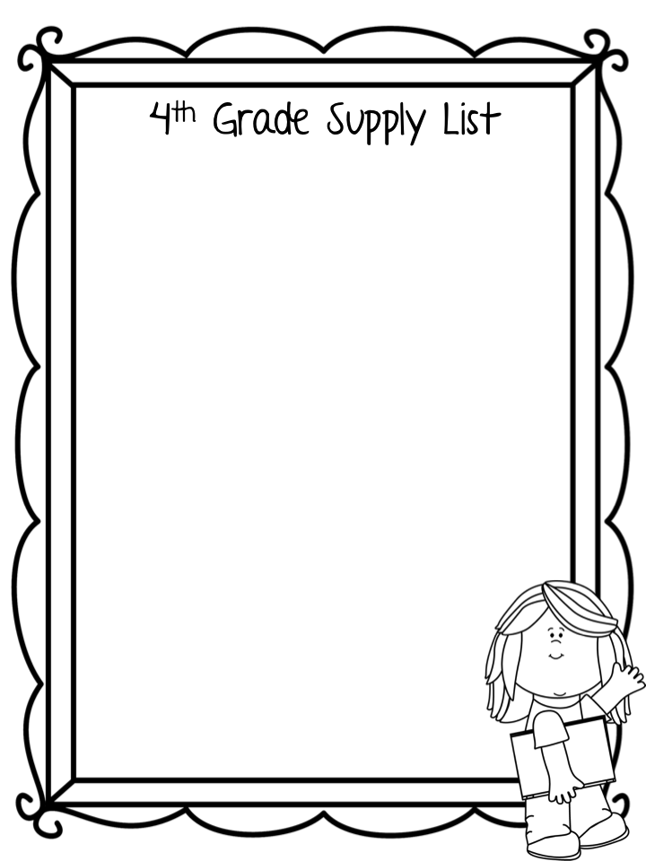
Backpack without wheels (1 standard size)
Pencil Pouch with zipper (1)
3 ring binder-1 inch (1)
Binder dividers (1)
Scissors (1 pair)
Glue sticks (4)
Pencils (24)
Cap Erasers (1 pack)
24-count crayons (1 box)
12-count colored pencils (1 box)
Highlighters (4)
Black Dry erase markers (4) - for student use
4 Folders with pockets & prongs
Composition notebooks (4)
Wide Rule Notebook paper (2 packs)
Box of tissues (1)
Sticky notes (3 pack)
Earbuds
Wish list items-
Lysol wipes Band-Aids
Tissues Ziploc Bags (gallon/quart)
Cardstock or colored printer paper
Dry Erase Markers

