Slide 1
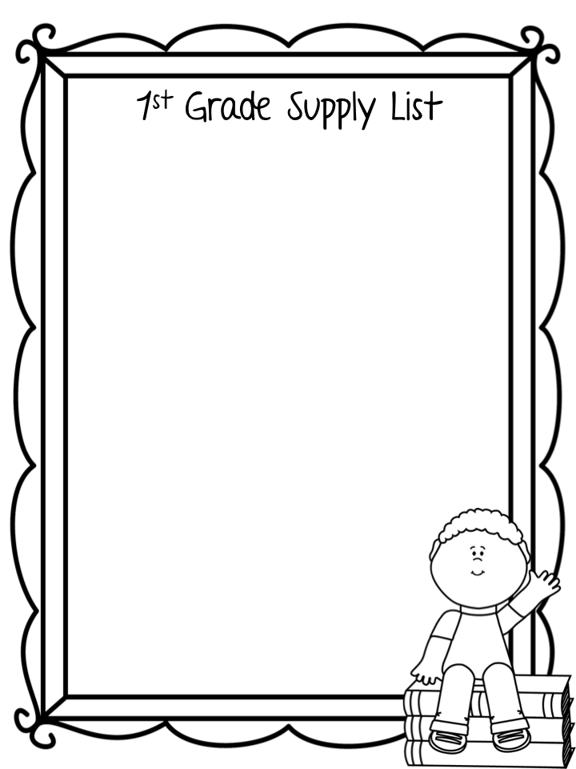
Backpack without wheels (1 standard size)
Plastic school box (5x8 inches) (1)
Scissors (1 pair)
Glue sticks (12)
Sharpened pencils (24)
Bar erasers (1 pack of 2)
24-count Crayons (4 boxes)
Yellow highlighters (4)
Black dry erase markers (8) - for student use
Solid color, plastic folders with pockets & prongs (2)
Composition notebooks (3)
Box of tissues (1)
Headphones
Sticky Notes (3 pack)
Disinfectant wipes (1)
Change of clothes to keep in cubby
Wish List Items
Paper Towels Cardstock
Clorox wipes Wet wipes Box of Tissue
Dry Erase Markers Hand Sanitizer
Snack size or sandwich size Ziploc bags

