Slide 1
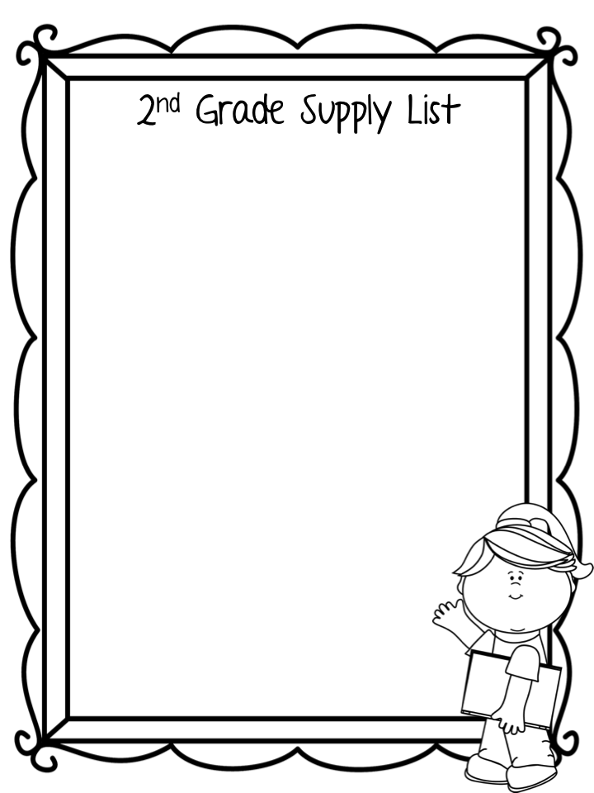
Backpack (1 standard size)
Plastic school box (1)
Erasers
Scissors (1 pair)
Glue sticks (12)
Pencils (24)
24-count crayons (4 boxes)
Washable color markers (1 box)
Highlighters (4)
Dry erase markers (8 black) for student use
Folders with pockets and prongs (4)
Composition notebooks (2)
Box of tissues (1)
Headphones
3-pack of sticky notes
Disinfectant wipes (1)
Wish list items-
Clorox wipes Paper Towels
Hand sanitizer Construction Paper
Tissues
Sandwich Size Ziploc Bags

