Slide 1
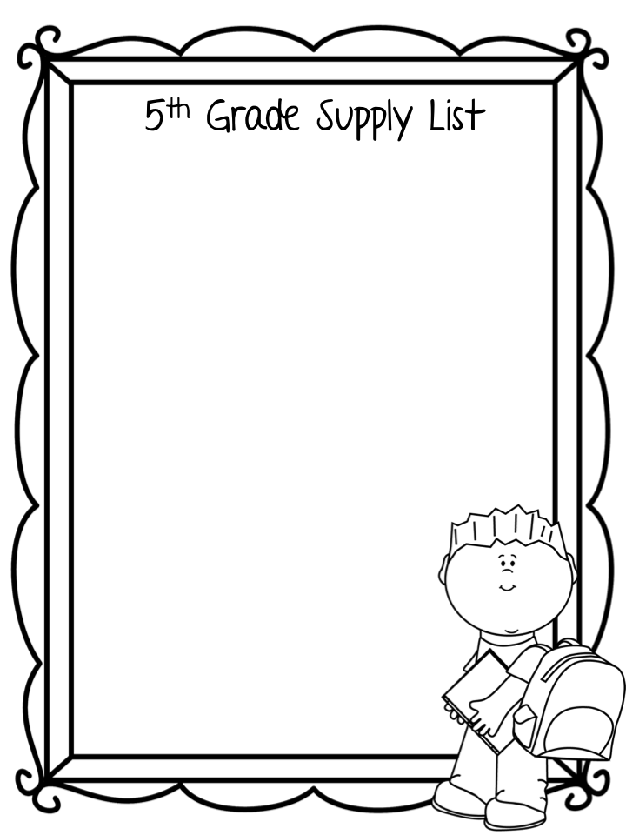
Backpack without wheels (1 standard size)
Pencil pouch with zipper (1)
Scissors (1 pair)
Glue sticks (4)
Pencils (24)
Cap Erasers (1 pack)
10-count markers (1 box)
12-count colored pencils (1 box)
Highlighters (4) – Different Colors
Black Dry erase markers (8) - for student use
Poly-Folders with pockets & prongs (4 plastic)
(1-red, 1 blue,1 yellow, 1 green)
Wide Ruled Composition Notebooks (8)- No Spiral
Box of tissues (1)
Sticky notes (3 pack)
Headphone
Wish List Items
Clorox wipes
Hand sanitizer
Tissues
Pencils
Dry Erase Markers
Paper Towels
Band Aids
Ziploc Bags (sandwich and gallon)

