Slide 1
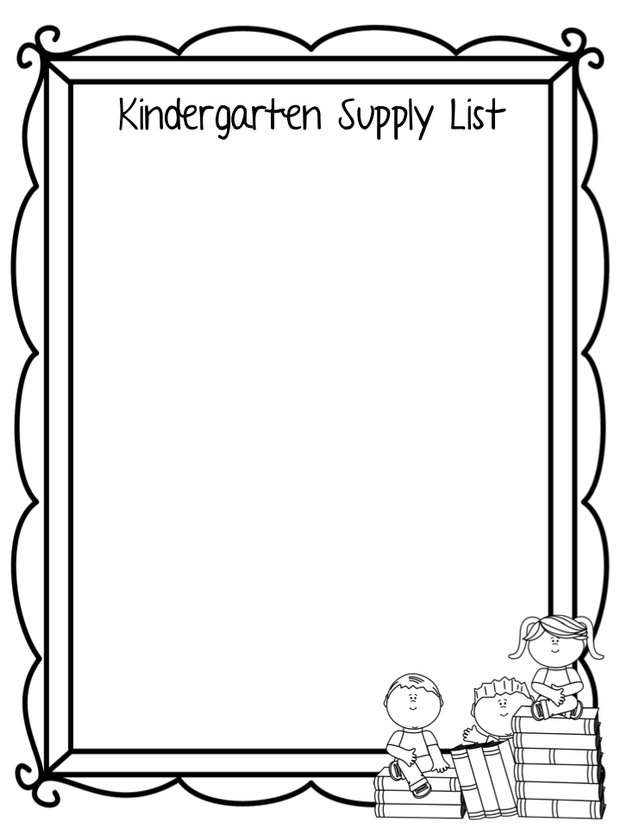
Backpack (1 standard size)
Plastic school box (5x8 inches) (1)
Scissors with rounded or blunt tips (1 pair)
Glue sticks (12)
Sharpened pencils (24)
24-count Crayons (4 boxes)
Washable color markers (1 box)
Highlighters (2)
Black Dry erase markers (4)
Solid color, plastic folders with pockets & prongs (4)
Composition notebooks (Primary Journals 2)
Box of tissues (1)
Headphones
Change of clothes to keep in cubby
Set of watercolor paint
3 oz or 4 oz of Play-doh (2)
Wish list items
Clorox wipes
Hand sanitizer
Gallon, quart or sandwich Ziploc bags
Roll of paper towels

