Slide 1
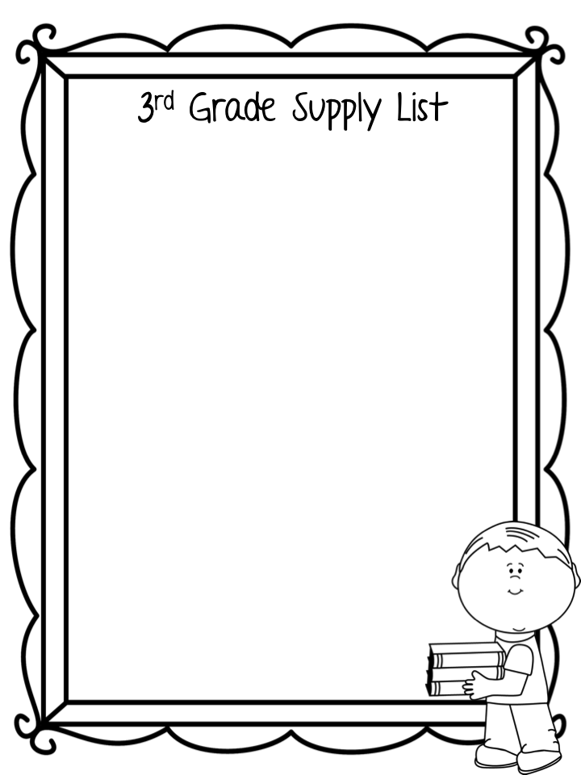
Backpack without wheels (1 standard size)
Large zipper pouch with binder holes(1)
Scissors (1 pair)
Glue sticks (8)
Pencils (24)
24-count crayons (2 boxes)
Highlighters (4) 4 different colors
Dry erase markers (4) - for student use
Folders (4 different colors, vinyl preferred)
Composition notebooks (3)
Wide Rule Notebook paper
3-ring 2 inch binder (1)
Box of tissues (1)
Headphones
Binder Dividers with pockets (1 pack)
Wish list items-
Lysol wipes Band-aides Cap Erasers
Hand sanitizer Tissues Extra Pencils
Ziploc Bags Page Protectors Lysol Spray
Paper Towels Sticky Notes

